Slide 1
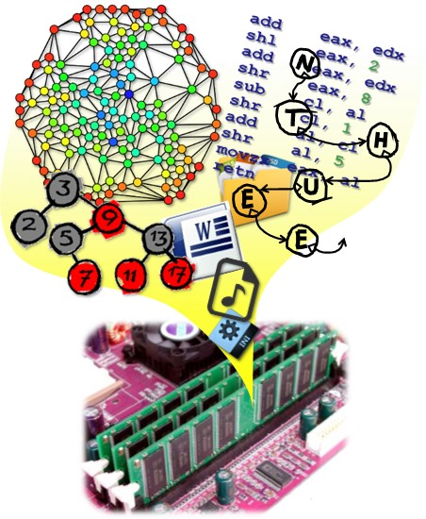
Data Structures
CH5 Trees
Prof. Tai-Lang Jong
Office: Delta 928
Tel: 42577
email: tljong@mx.nthu.edu.tw
Spring 2021

Slide 2
為什麼要各種 data structures
舉例：儲存全台灣學生的學號、姓名
Array
最節省空間
Linked list
新增(insert)、刪除(delete) 速度快
Tree
Hierarchically ordered data
搜尋(search) 速度快
Graph
表達學生間的關聯性

Slide 3
Outline
5.1 Introduction
5.2-5.5 Binary trees
5.6 Heaps
5.7 Binary search trees
5.8 Selection trees
5.9 Forests
(5.10 Disjoint sets)
(5.11 Counting binary trees)
Make Money Fast!
Stock Fraud
Ponzi Scheme
Bank Robbery

Slide 4

Nature Lover’s View of a Tree
leaves
branches
root

Slide 5

Computer Scientist’s View
root
leaves
branches
nodes

Slide 6
Tree-Type Charts
Pedegree
Dusty
ancestor
Honey Bear
Brandy
No inbreeding
Brunhilde
Terry
Coyote
Nugget
Gill
Tansey
Tweed
Zoe
Crocus
Primrose
Nous
Belle
Lineal
Proto Indo-European
descendants
Italic
Hellenic
Germanic
Osco-Umbrian
Latin
Greek
North
West
Oscan
Umbrian
Spanish
French
Italian
Icelandic
Norwegian
Swedish
Low
High
Yiddish

Slide 7
Linear Lists and Trees
Linear lists are useful for serially ordered data.
L = (e₀, e₁, e₂, …, e_{n-1})
Days of week.
Months in a year.
Students in this class.
Trees are useful for hierarchically ordered data.
Employees of a corporation.
President, vice presidents, managers, and so on.
Organization chart of a corporation.
File systems, DBs
Programming environments (e.g., C++ single inheritance)
…

Slide 8
Hierarchical Data and Trees
Tree: a nonlinear data structure
In computer science, a tree is an abstract model of a hierarchical structure
A tree T is a set of nodes storing elements in a parent-child relationship with properties:
T has a special node r called the root of T with no parent node (T not empty) which is at the top of the hierarchy
Each node v of T different from r has a unique parent node u
Elements next in the hierarchy are the children of the root.
Elements next in the hierarchy are the grandchildren of the root, and so on.
Elements that have no children are leaves.

Slide 9
Example Tree
President
root
VP1
VP2
VP3
children of root
Manager1
Manager2
Manager
Manager
grand children of root
Worker Bee
great grand child of root

Slide 10
Example Tree
Computers”R”Us
Sales
Manufacturing
R&D
US
International
Laptops
Desktops
Europe
Asia
Canada

Slide 11
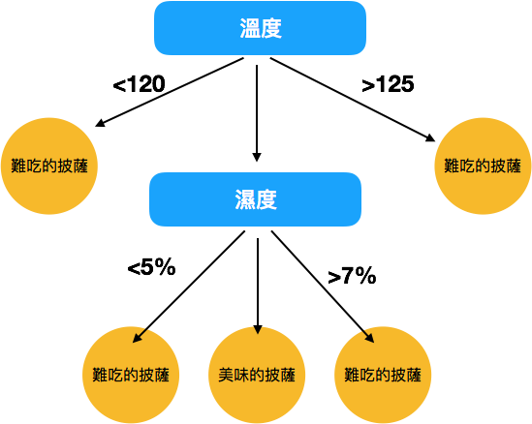
Decision Tree

Slide 12
Binary Decision Tree
question
Want a fast meal?
Yes
No
How about coffee?
On expense account?
Yes
No
Yes
No
decision
Starbucks
In ‘N Out
Antoine's
Denny’s

Slide 13

Binary Decision Tree

Slide 14
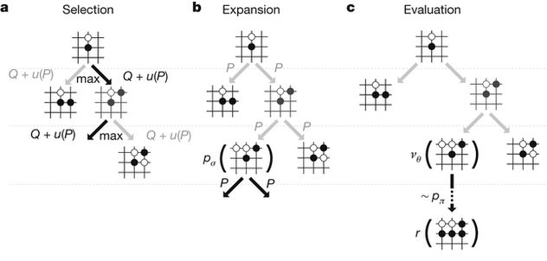
Game Tree

Slide 15
Definition
A tree is a finite set of one or more nodes (not empty) such that
There is a specially designated node called the root
The remaining nodes are partitioned into n ≥ 0 disjoint sets T₁, T₂, .., T_{n}, where each of these sets is a tree. T₁, .., T_{n} are called the subtrees of the root.
Proto Indo-European
Italic
Hellenic
Germanic
Osco-Umbrian
Latin
Greek
North
West
Oscan
Umbrian
Spanish
French
Italian
Icelandic
Norwegian
Swedish
Low
High
Yiddish

Slide 16
Subtrees
T₁, .., T₃ are called the subtrees of the root A.
root
T₂
T₃
T₁

Slide 17
Terminologies
Root: node without parent (A)
Degree of node: The number of subtrees (children) of a node is called the node's degree
Leaf nodes: Nodes that have degree zero are called leaf or terminal nodes (or external nodes, the remaining nodes are internal nodes)
Degree of a tree: is the maximum of the degree of the nodes in a tree
Children: The root of the subtrees of a node X are the children of X, and X is the parent of its children
Sibling: Children of the same parent are siblings (兄弟姊妹)

Slide 18
Terminologies
Ancestors of a node v: all the nodes along the path from the root to that node, i.e., parent, grandparent, grand-grandparent, etc. up to root node
Descendant of a node v: child, grandchild, grand-grandchild, etc. or the nodes in the subtree rooted by v
Subtree: tree consisting of a node and its descendants
Level of a node v: is defined by letting the root be at level one. If a node is at level i, then its children (if any) are at level i+1
Level of a tree = max {level of a node in T}
Depth of a node v: d_{v} = number of ancestors + node itself = level(v) (some texts exclude node itself)
Height of a tree: maximum depth of any node
Height of a node v = 1 + max{height(child(v))}

Slide 19
Node Degree = Number of Children
3
2
1
3
2
0
0
1
0
0
0
0
0
The number of subtrees of a node is called the node's degree
Nodes that have degree zero are called leaf or terminal nodes

Slide 20
Tree Degree = Max Node Degree
3
2
1
3
2
0
0
1
0
0
0
0
0
The degree of a tree is the maximum of the degree of the nodes in a tree
The degree of the example tree is 3

Slide 21
Leaves
0
0
0
0
0
0
0
Nodes that have degree zero are called leaf or terminal nodes

Slide 22
Parent, Grandparent, Siblings, Ancestors, Descendants
The root of the subtrees of a node X are the children of X, and X is the parent of its children
Children of the same parent are siblings (兄弟姊妹)

Slide 23
Parent, Grandparent, Siblings, Ancestors, Descendants
A is the parent to B, C, and D; D is parent to H,I,J;
A is the grandparent of E, F, G, H, I, and J;
B, C, D are siblings, so are E and F, G has no sibling, H, I, and J are siblings
All nodes from B, to M are descendants of A

Slide 24
Levels
The level of a node is defined by letting the root be at level one.
If a node is at level i, then its children are at level i+1

Slide 25
Caution
Some texts start level numbers at 0 rather than at 1.
Root is at level 0.
Its children are at level 1.
The grand children of the root are at level 2.
And so on.
We shall number levels with the root at level 1.

Slide 26
Depth and Height
Let v be a node of a tree T, the depth of a node v, d_{v}, is the number of ancestors of v, including v itself (depth of v = level of v)
The depth of node v is recursively defined as follows:
int depth(const Tree& T, const Position& v){
if (T.isRoot(v)) return 1; // d_{v}(root) = 1
else return 1+depth(T, T.parent(v));
}
1
A
2
B
C
D
3
Running time of depth(T,v)
= O(1+d_{v})
In worst case: O(n)
E
F
G
H
4
I
J
K

Slide 27
Depth and Height
The height of a node v in tree T is also defined recursively
The height of v is one plus the maximum height of a child of v h(v) = 1+max{h(child(v))}
(define height of external (leaf) node = 1)
The height (h) of a tree T is the height of the root of T
The height of a tree T is equal to the maximum depth of an external node of T
height(v) =1 + max{height(child(v))}

Slide 28
Height = Depth = Number of Levels
height(v) = 1 + max{height(child(v))}
h(A) = 1+max{3,2,3} = 4
h(B) = 1+max{2,1} = 3
h(C) = 1+max{1} = 2
h(K) = 1
height
4
3
2
1
The height of the tree = the depth of the tree = the maximum level of any node in the tree = the number of levels of the tree = 4

Slide 29
Nodes and Branches
Let T be a tree with n nodes, and let c_{v} denote the number of children (number of branches) of node v of T (degree of v). Then
Σ_{v∈T} c_{v} = n-1
Justification:
Each node of T, with the exception of the root, is a child of another node, and thus contributes one unit to the above sum.
A
3
B
2
2
C
D
0
E
F
3
G
H
0
0
0
I
J
K
0
0
0
3+2+2+3=10=11-1

Slide 30
Ordered Tree
Ordered tree: if there is a linear ordering defined for the children of each node, i.e., we can identify children as being the first, second, third, and so on.
Such an ordering is usually indicated in a drawing of a tree by arranging siblings left to right, corresponding to their linear relationship.
1
A
Ordered tree typically indicate the linear order relationship existing between siblings by listing them in a sequence or iterator in the correct order.
2
B
3
C
4
D
5
E
6
F
7
G
8
H
9
I
10
J
11
K

Slide 31
Tree Example: Structured Document
Structured document: such as a book, is hierarchically organized as a tree whose internal nodes are chapters, sections, subsections, and whose external nodes are paragraphs, tables, figures, the bibliography, and so on.
Make Money Fast!
1. Motivations
2. Methods
References
2.2 Ponzi Scheme
2.3 Bank Robbery
q
q
1.1 Greed
1.2 Avidity
2.1 Stock Fraud
q
q
q
q

Slide 32
Representation of Trees
List representation
The information in the root node comes first, followed by a list of the subtrees of that node
Leads to a memory representation of trees that is the same as that used for generalized list
Left Child – Right Sibling representation
Representation as a Degree-Two Tree

Slide 33
List Representation
The information in the root node comes first, followed by a list of the subtrees of that node – generalized list
→ (A (B(…), C(…), D(…)))
(A (B(E(…), F), C(G), D(H(…), I, J)))
(A (B(E(K, L), F), C(G), D(H(M), I, J)))

Slide 34
List Representation
A
0
B
F
0
C
G
0
D
I
J
0
subtree/sublist
E
K
L
0
H
M
0

Slide 35
More Specialized List Node
Represent each tree node by a memory node that has fields for the data and pointers to the tree node’s children.
Since the degree of each tree node may be different, we may be tempted to use memory nodes with a varying number of pointer fields – more difficult than using nodes of fixed size to represent tree node.
DATA | CHILD 1 | CHILD 2 | …… | CHILD k

Slide 36
Lemma 5.1
If T is a k-ary tree (i.e., a tree of degree k) with n nodes, each having a fixed size as shown below, then n(k-1) + 1 of the nk child fields are 0, n ≥ 1.
DATA | CHILD 1 | CHILD 2 | …… | CHILD k
Proof: Since each nonzero child field points to a node and there is exactly one pointer to each node other than the root, the number of non-zero child fields in an n-node tree is exactly n-1.
The total number of child fields in a k-ary tree with n nodes is nk. Hence, the number of zero fields is nk – (n-1) = n(k-1) + 1, n ≥ 1.

Slide 37
Left Child-Right Sibling Representation
Data
left child | right sibling

Slide 38
Left Child-Right Sibling Representation
Data
A
Left child
right sibling
B
C
D
0
E
F
G
H
I
J
0
0
0
0
0
0
0
K
L
M
0
0
0
0
0

Slide 39
Degree-Two Tree Representation
We can represent any tree as a degree-two tree (binary tree)
Any tree
Degree two
4 levels
7 leafs
7 levels
5 leafs
Left child right sibling
(No right sibling)
Binary tree

Slide 40
Tree Representations

Slide 41
Tree Traversal
A traversal visits the nodes of a tree in a systematic manner
In a preorder traversal (VL..R) , a node is visited before its descendants
Application: print a structured document (tree printing)
In a postorder traversal (L..RV) , a node is visited after its descendants
Application: compute space used by files in a directory and its subdirectories
Inorder traversal : (LVR) especially for binary tree
Level order traversal : level by level traversal

Slide 42
Preorder Traversal
In a preorder traversal (VL..R), a node is visited before its descendants
Application: print a structured document (tree printing)
Algorithm Preorder(T, v)
perform the “visit” action for node v
for each child w of v do
recursively traverse the subtree
rooted at w by calling Preorder(T, w)
Algorithm Preorder(v)
visit(v) -- O(1)
for each child w of v –- O(c_{v})
Preorder(w)

Slide 43
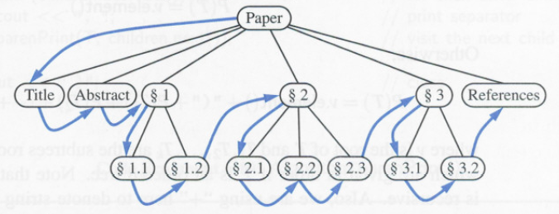
Preorder Traversal for tree printing
void preorderPrint(const Tree& T, const Position& v){
cout << v.element(); // print element
PositionIterator children = T.children(v);
while (children.hasNext()) { // visit children
preorderPrint(T, children.next());
cout << “ “;
}
}

Slide 44
Using Preorder Traversal for Representing a Tree
Parenthetic string representation P(T) of a tree is recursively defined as follows:
Algorithm P(T) (ParenPrint())
If T consists of single node then
P(T) = v.element(),
otherwise
P(T) = v.element()+”(“+P(T₁)+P(T₂)+…..+P(T_{k})+”)”
where v is the root of T and T₁, T₂,…T_{k} are the subtrees rooted at the children of v, which are given in order if T is an ordered tree. We use “+” as the string concatenation.

Slide 45
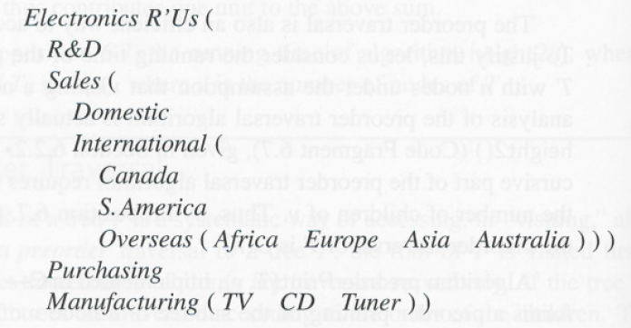
ParenPrint()
Electronics’R’Us
R&D
Sales
Purchasing
Manufacturing
Domestic
International
TV
CD
Tuner
Canada
S.America
Overseas
Africa
Europe
Asia
Australia

Slide 46
Postorder Traversal
In a postorder traversal, a node is visited after its descendants
Application: compute space used by files in a directory and its subdirectories
Algorithm Postorder(T, v)
for each child w of v do
recursively traverse the subtree
rooted at w by calling Postorder(T, w)
perform the “visit” action for node v
Algorithm Postorder(v)
for each child w of v
Postorder (w)
visit(v)

Slide 47
Postorder Traversal
The postorder traversal method is useful for solving problems where we wish to compute some property for each node v in a tree, but computing that property for v requires that we have already computed that same property for v’s children. E.g. compute disk space of a directory.
9
cs16/
8
3
7
todo.txt 1K
homeworks/
programs/
1
2
4
5
6
h1c.doc 3K
h1nc.doc 2K
DDR.java 10K
Stocks.java 25K
Robot.java 20K

Slide 48
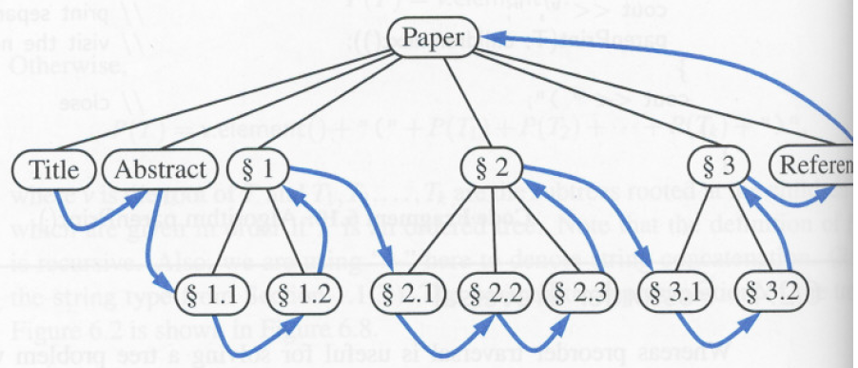
Postorder Traversal: postorderPrint
void postorderPrint(const Tree& T, const Position& v){
PositionIterator children = T.children(v);
while (children.hasNext()) { // visit children
postorderPrint(T, children.next());
cout << “ “;
}
cout << v.element(); // print element
}

Slide 49
A Postorder Algorithm For Computing Disk Usage
int diskSpace(const Tree& T, const Position& v){
int s = size(v); // start with size of v
PositionIterator children = T.children(v);
while (children.hasNext())
s += diskSpace(T, children.next()); //add weights of subtree
if (T.isInternal(v))
cout << name(v) << “: “ << s << endl;
return s;
}

Slide 50
Outline
5.1 Introduction
5.2-5.5 Binary trees
5.2 Basics
5.3 Traversal and iterators
5.4 Additional operations
5.5 Threaded binary tree
5.6 Heaps
5.7 Binary search trees
5.8 Selection trees
5.9 Forests
(5.10 Disjoint sets)
(5.11 Counting binary trees)

Slide 51
Binary Tree
Definition: A binary tree is a finite set of nodes that either is empty or consists of a root and two disjoint binary trees called the left subtree and the right subtree
A BT is an ordered tree in which every node has at most two children-- Left child & right child
A binary tree, T, is either empty or such that:
T has a special node called the root node r;
T has two sets of nodes, LT and RT, called the left subtree and right subtree of T (rooted by the left child and right child of root r), respectively;
LT and RT are binary trees

Slide 52
ADT 5.1 BinaryTree ADT
template<class T>
class BinaryTree
{ // objects: A finite set of nodes either empty or consisting
// of a root node, left BinaryTree and right BinaryTree
public:
BinaryTree(); // constructor for an empty binary tree
bool IsEmpty();
// return true iff the binary tree is empty
BinaryTree(BinaryTree<T>& bt1, T& item, BinaryTree<T>& bt2);
// constructor given the root item and left subtrees bt1 and
// right subtree bt2
BinaryTree<T> LeftSubtree(); // return the left subtree
BinaryTree<T> RightSubtree();// return the right subtree
T RootData(); // return the data in the root node of *this
};

Slide 53
Differences Between a Tree & a Binary Tree
No node in a binary tree may have a degree more than 2, whereas there is no limit on the degree of a node in a tree.
A binary tree may be empty (zero nodes); a tree cannot be empty (at least one node).
The subtrees of a binary tree are ordered; those of a tree are not ordered, i.e., Order of children matters for binary trees

Slide 54
Differences Between A Tree & A Binary Tree (cont.)
The subtrees of a binary tree are ordered; those of a tree are not ordered, i.e., Order of children matters for binary trees
Are different when viewed as binary trees.
Are the same when viewed as trees.

Slide 55
Other Definitions
Skewed and complete binary tree
Skewed to the left
Complete
Note: for complete binary trees, all leaf nodes are on adjacent levels
Full binary tree (all leafs at the same level)
Proper binary tree (internal node has degree 2)

Slide 56
Properties of Binary Tree
Minimum number of nodes in a binary tree whose height is h.
At least one node at each of first h levels.
minimum number of nodes is h

Slide 57
Maximum Number of Nodes
All possible nodes at first h levels are present.
Maximum number of nodes
= 1 + 2 + 4 + 8 + … + 2^{h-1}
= 2^{h} - 1
Full binary tree

Slide 58
Number of Nodes & Height
Let n be the number of nodes in a binary tree whose height is h.
h ≤ n ≤ 2^{h} – 1
log₂(n+1) ≤ h ≤ n

Slide 59
Lemma 5.2 Maximum Number of Nodes
Properties
Maximum number of nodes at level i of a binary tree is 2^{i-1}.
Maximum number of nodes of a binary tree of depth k is 2^{k}-1, k ≥ 1.
Proof
Induction base: the root is the only node at level 1.
Induction hypothesis: maximum number of nodes at level (i-1) is 2^{i-2}, which is true for i-1 = 1.
Induction step: Each node has at most two children, therefore the number of nodes at level (i) is 2 x 2^{i-2} = 2^{i-1}.

Slide 60
Lemma 5.3 Leaf Nodes vs. Degree-2 Nodes
Properties
For any nonempty binary tree, T, if n₀ is the number of leaf nodes and n₂ the number of nodes of degree 2 → n₀=n₂+1
Proof
Let n₁ be the number of nodes of degree one and n the total number of nodes
We have n = n₀ + n₁ + n₂
Each node except the root has a branch leading into it
n -1 = B, where B is the number of branches
B = n₁ + 2n₂
n = B+1 = n₁ + 2n₂ +1 = n₀ + n₁ + n₂
→ n₀=n₂+1

Slide 61
Full & Complete Binary Trees
Definition: A full binary tree of depth k is a binary tree of depth k having 2^{k}-1 nodes, k ≥ 0
We number the nodes in the full binary tree level by level, left to right
Definition: A binary tree with n nodes and depth k is complete iff its nodes correspond to the nodes numbered from 1 to n in the full binary tree of depth k
full binary tree
From lemma 5.2, the height of a complete binary tree with n nodes is ceiling(log₂n)

Slide 62
Full Binary Tree
A full binary tree of a given height h has 2^{h} – 1 nodes.
Height 4 full binary tree → 2⁴ -1 = 15 nodes.

Slide 63
Numbering Nodes In A Full Binary Tree
Number the nodes 1 through 2^{h} – 1.
Number by levels from top to bottom.
Within a level number from left to right.

Slide 64
Lemma 5.4 Complete Binary Tree
If a complete binary tree with n nodes is represented sequentially, then for any node with index i, 1 ≤ i ≤ n, we have the following properties:
parent(i) is at floor(i/2), if i ≠ 1. If i = 1, i is the root and has no parent.
leftChild(i) is at 2i if 2k ≤ n. If 2i > n then i has no left child.
rightChild(i) is at 2i + 1 if 2i + 1 ≤ n. If 2i + 1 > n then i has no left child.
tree[]
0
5
10
15
index i: 0 1 2 3 4 5 6 7 8 9 10 11 12 13 14 15

Slide 65
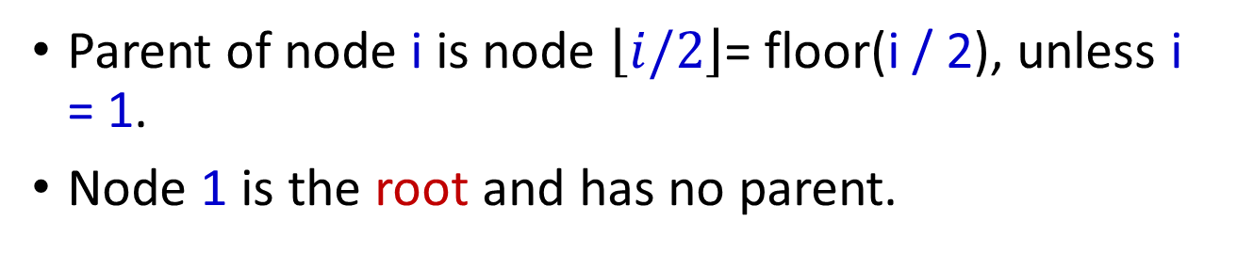
Node Number Property 1
Parent of node i is node $\left\lfloor \left.i/2\right\rfloor \right.$= floor(i / 2), unless i = 1.
Node 1 is the root and has no parent.

Slide 66
Node Number Property 2
Left child of node i is node 2i, unless 2i > n, where n is the number of nodes.
If 2i > n, node i has no left child.

Slide 67
Node Number Property 3
Right child of node i is node 2i+1, unless 2i+1 > n, where n is the number of nodes.
If 2i+1 > n, node i has no right child.

Slide 68
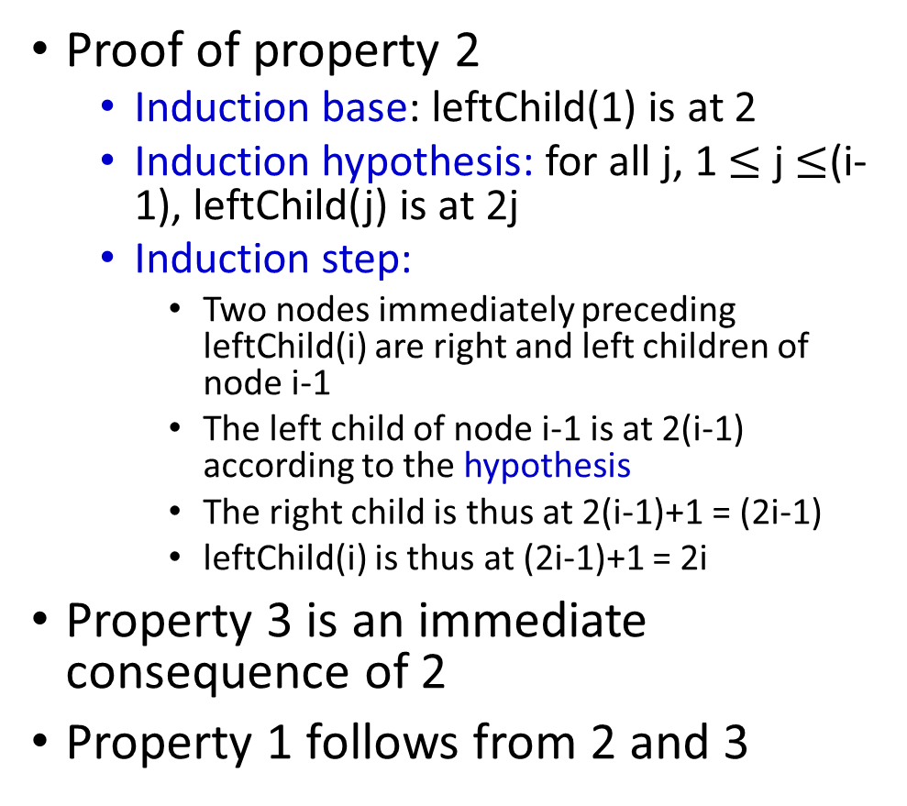
Proofs of Binary Tree Properties
Proof of property 2
Induction base: leftChild(1) is at 2
Induction hypothesis: for all j, 1 $≤$ j $≤$(i-1), leftChild(j) is at 2j
Induction step:
Two nodes immediately preceding leftChild(i) are right and left children of node i-1
The left child of node i-1 is at 2(i-1) according to the hypothesis
The right child is thus at 2(i-1)+1 = (2i-1)
leftChild(i) is thus at (2i-1)+1 = 2i
Property 3 is an immediate consequence of 2
Property 1 follows from 2 and 3
i-1
i
2(i-1)
?
leftChild(i)

Slide 69
Complete Binary Tree With n Nodes
Start with a full binary tree that has at least n nodes.
Number the nodes as described earlier.
The binary tree defined by the nodes numbered 1 through n is the unique n node complete binary tree.
Complete binary tree with 10 nodes.

Slide 70
Properties of Binary Tree
Let n be the number of nodes in a binary tree T whose height is h. The number of external (leaf) node (n₀); number of internal node (n₁ + n₂); the number of branches B;
B = n - 1 = n₁ + 2n₂ , n = n₀ + n₁ + n₂ → n₀ = n₂ + 1
h ≤ n ≤ 2^{h} – 1, → log₂(n+1) ≤ h ≤ n
The number of external node (n₀): 1 ≤ n₀ ≤ 2^{h-1}
The number of internal node (n₁ + n₂):
h-1 ≤ n₁ + n₂ ≤ 2^{h-1} -1
The total number of node n: h ≤ n ≤ 2^{h} -1
The height h: log₂(n+1) ≤ h ≤ n
In a proper BT (all internal node is n₂), the number of external node is one more than the number of internal node: n₀ = n₂ + 1

Slide 71
Arithmetic Expression Tree
Binary tree associated with an arithmetic expression
internal nodes: operators (to compute the value of the internal node using the values of its left child and right child)
external nodes: operands (constant or variable)
Example: arithmetic expression tree for the expression (2 × (a − 1) + (3 × b))
+
×
×
2
−
3
b
a
1

Slide 72
(Binary) Decision Tree
Binary tree associated with a decision process
internal nodes: questions with yes/no answer
external nodes: decisions
Example: dining decision
Want a fast meal?
Yes
No
How about coffee?
On expense account?
Yes
No
Yes
No
Starbucks
In ‘N Out
Antoine's
Denny’s

Slide 73
Binary Tree Representation
Array representation.
Linked representation.

Slide 74
Array Representation of a Binary Tree
Number the nodes using the numbering scheme for a full binary tree.
The node that is numbered i is stored in tree[i].
tree[ ]
[0]
[1]
[2]
…
parent(i) is at floor(i/2)
left Child(i) is at 2i
rightChild(i) is at 2i + 1
[15]

Slide 75
Array Representation Examples
Sequential Representation:
(1) waste space
(2) insertion/deletion problem

Slide 76
Right-Skewed Binary Tree
1
a
b
7
c
d
tree[]
a
-
b
-
-
-
c
-
-
-
-
-
-
-
d
0
5
10
15
An n node binary tree needs an array whose length is between n+1 and 2^{n}.

Slide 77
Linked Representation for a Binary Tree
Drawbacks of the array representation
Good for complete/full binary tree but wasteful of space for many other trees
Tree manipulation can incur excessive data movement
Linked representation tackles the problems
Each binary tree node is represented as an object whose data type is TreeNode.
The space required by an n node binary tree is
n * (space required by one node).

Slide 78
Linked Representation for a Binary Tree
template <class T> class Tree; //forward declaration
template <class T>
class TreeNode {
friend class Tree <T>;
private:
T data;
TreeNode <T> *leftChild;
TreeNode <T> *rightChild;
};
template <class T>
class Tree{
public:
// tree operations
private:
TreeNode <T> *root;
};

Slide 79
Linked Representation Example
root
a
b
c
e
d
g
f
leftChild
leftChild
data
data
h
rightChild
rightChild

Slide 80
Linked Representation for a Binary Tree

Slide 81
Some Binary Tree Operations
Determine the height.
Determine the number of nodes.
Make a clone.
Determine if two binary trees are clones.
Display the binary tree.
Evaluate the arithmetic expression represented by a binary tree.
Obtain the infix form of an expression.
Obtain the prefix form of an expression.
Obtain the postfix form of an expression.

Slide 82
Compute Height of Tree
For a tree T having n nodes, |E| external nodes, height h:
d_{v} ≤ h ≤ n for each node v (d_{v} = number of ancestors + 1)
|E| ≤ n-1
The height of v = max{depth of child(v)} – d_{v}
The height of v = the height of subtree T’ rooted on v
Algorithm height2(T, v)
if(T.isExternal(v))
return 1 //leaf node height = 1
else
h = 0;
for each w in T.children(v) do
h = max(h,height2(T,w))
return h+1

Slide 83
Outline
5.1 Introduction
5.2-5.5 Binary trees
5.2 Basics
5.3 Traversal and iterators
5.4 Additional operations
5.5 Threaded binary tree

Slide 84
Binary Tree Traversal
Many binary tree operations are done by performing a traversal of the binary tree.
In a traversal, each element of the binary tree is visited exactly once.
During the visit of an element, all action (operation like make a clone, display, evaluate the operator, etc.) with respect to this element is taken.
Full traversal produces a linear order for the nodes in a tree
Linearized sequence of a binary tree can be useful

Slide 85
Binary Tree Traversal Methods
Preorder
Inorder
Postorder
Level order
Full traversal produces a linear order for the nodes in a tree
Linearized sequence of a binary tree can be useful
+
Level-order traversal
+ * E * D / C A B
*
E
Preorder traversal
+ * * / A B C D E
(prefix)
*
D
Inorder traversal
A / B * C * D + E
(infix)
/
C
A
B
Postorder traversal
A B / C * D * E +
(postfix)
BT with arithmetic expression

Slide 86
Preorder, Inorder, and Postorder
Let us define
L moving left
V visiting the node
R moving right
Possible combinations of traversal
Various positions of the V with respect to the L and R
 |  |  | Mirror L & R
Preorder | VLR |  | VRL
Inorder (V is in between L and R) | LVR |  | RVL
Postorder | LRV |  | RLV
mirrored orders are less widely used

Slide 87
Inorder Traversal
template <class T>
void Inorder(TreeNode<T> *t)
{
if (t != NULL)
{
Inorder(t->leftChild);
Visit(t);
Inorder(t->rightChild);
}
}

Slide 88
Inorder Example (Visit = Print)
a
A
b
c
B
C
f
d
e
B
A
C
g
j
h
i
g
d
h
b
e
i
a
f
j
c

Slide 89
Inorder By Projection (Squishing)
a
b
c
f
d
e
g
j
h
i
g
d
h
b
e
i
a
f
j
c

Slide 90
Inorder of Expression Tree
/
*
+
e
f
+
-
a
b
c
d
a
+
b
*
c
-
d
/
e
+
f
Gives infix form of expression (sans parentheses)!

Slide 91
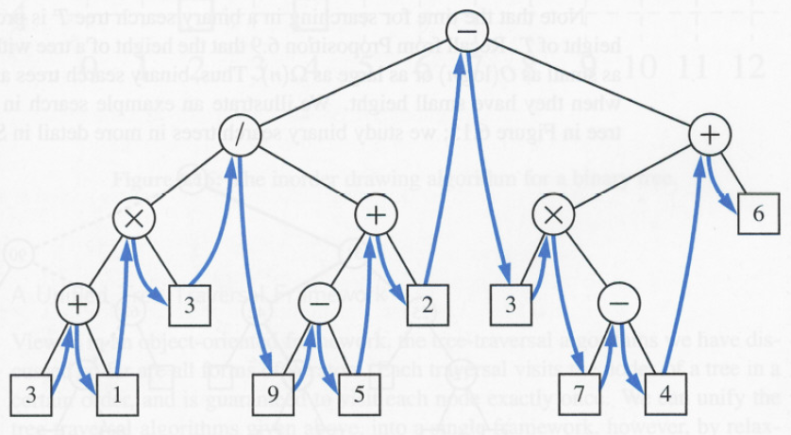
Inorder of Expression Tree
For every node v, the inorder traversal visits v after all the nodes in the left subtree of v and before all the nodes in the right subtree of v

Slide 92
Program 5.1 Inorder (LVR)
template <class T>
void Tree<T>::Inorder()
{// driver呼叫主程式以走訪整棵樹
Inorder(root);//Traverse inorderly
}
template <class T>
void Tree<T>::Inorder(TreeNode<T> * p)
{ // Workhorse走訪樹根為p的子樹
if(p) {
Inorder(p->leftChild); // L
Visit(p); // **V**
Inorder(p->rightChild); // R
}
}
template <class T>
void Tree<T>::Visit(TreeNode<T> * p)
{
cout << p->data;
}
+
*
E
*
D
/
C
A
B
A / B * C * D + E

Slide 93
Trace of Program 5.1
 | currentNode |  |  | currentNode
Call of inorder | 裡的值 | Action | Call of inorder | 裡的值 | Action
Driver | + |  | 10 | C
1 | * |  | 11 | 0
2 | * |  | 10 | C | cout << ‘C’
3 | / |  | 12 | 0
4 | A | cout << ‘A’ | 1 | * | cout << ‘*’
5 | 0 |  | 13 | D
4 | A |  | 14 | 0
6 | 0 |  | 13 | D | cout << ‘D’
3 | / | cout << ‘/’ | 15 | 0
7 | B |  | Driver | + | cout << ‘+’
8 | 0 |  | 16 | E
7 | B | cout << ‘B’ | 17 | 0
9 | 0 |  | 16 | E | cout << ‘E’
2 | * | cout << ‘*’ | 18 | 0

Slide 94
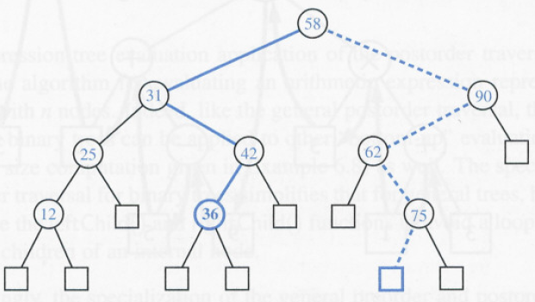
Binary Tree Search
Inorder traversal can be applied for binary tree searching when we stored an ordered sequence of elements in a binary tree.
<
>
=

Slide 95
Preorder Traversal
In a preorder traversal, a node is visited before its descendants
Application: print a structured document (tree printing)
template <class T>
void Preorder(TreeNode<T> *t)
{
if (t != NULL)
{
Visit(t);
Preorder(t->leftChild);
Preorder(t->rightChild);
}
}

Slide 96
Preorder Example (Visit = Print)
a
A
b
c
B
C
f
d
e
A
B
C
g
j
h
i
a
b
d
g
h
e
i
c
f
j

Slide 97
Preorder of Expression Tree
/
*
+
e
f
+
-
a
b
c
d
/
*
+
a
b
-
c
d
+
e
f
Gives prefix form of expression!

Slide 98
Program 5.2 Preorder (VLR)
template <class T>
void Tree<T>::Preorder()
{ // Driver
Preorder(root); //Traverse preorderly
}
template <class T>
void Tree<T>::Preorder(TreeNode<T> * p)
{// Workhorse, a recursive function
if(p) {
Visit(p); // **V**
Preorder(p->leftChild); // L
Preorder(p->rightChild); // R
}
}
template <class T>
void Tree<T>::Visit(TreeNode<T> * p)
{
cout << p->data;
}
+
*
E
*
D
/
C
A
B
+ * * / A B C D E

Slide 99
Postorder Traversal
In a preorder traversal, a node is visited after its descendants
template <class T>
void Tree<T>::Postorder(TreeNode<T> *t)
{ // Workhorse
if (t)
{
Postorder(t->leftChild);
Postorder(t->rightChild);
Visit(t);
}
}

Slide 100
Postorder Example (Visit = Print)
a
A
b
c
B
C
f
d
e
B
C
A
g
j
h
i
g
h
d
i
e
b
j
f
c
a

Slide 101
Postorder of Expression Tree
/
*
+
e
f
+
-
a
b
c
d
a
b
+
c
d
-
*
e
f
+
/
Gives postfix form of expression!

Slide 102
Program 5.3 Postorder (LRV)
template <class T>
void Tree<T>::Postorder()
{
Postorder(root);//Traverse postorderly
}
template <class T>
void Tree<T>::Postorder(TreeNode<T> * p)
{// Workhorse, a recursive function
if(p) {
Postorder (p->leftChild); // L
Postorder (p->rightChild); // R
Visit(p); // **V**
}
}
template <class T>
void Tree<T>::Visit(TreeNode<T> * p)
{
cout << p->data;
}
+
*
E
*
D
/
C
A
B
A B / C * D * E +

Slide 103
Euler Tour Traversal
Generic traversal of a binary tree
Includes as special cases the preorder, postorder and inorder traversals
Walk around the tree and visit each node v three times:
on the left (preorder)
from below (inorder)
on the right (postorder)
If the node v is external, then these three “visits” actually happen at the same time.
Draw the contour of the tree
A
B
C
D
E
F
G
H
Attach a point to each node
preorder
postorder
I
J
K
L
inorder

Slide 104
Euler Tour Traversal -- Preorder
Attach a point to each node
Draw the contour of the tree
preorder
A
→ABDFIGJKCEHL
B
C
D
E
F
G
H
I
J
K
L

Slide 105
Euler Tour Traversal -- Inorder
Attach a point to each node
Draw the contour of the tree
A
inorder
→IFDJGKBACELH
B
C
D
E
F
G
H
I
J
K
L

Slide 106
Euler Tour Traversal -- Postorder
Attach a point to each node
Draw the contour of the tree
postorder
A
→IFJKGDBLHECA
B
C
D
E
F
G
H
I
J
K
L

Slide 107
Non-Recursive Traversal Algorithm
Binary tree is a type of container
We thus want to implement an iterator for a binary tree
We need a non-recursive traversal algorithm
Such an iterator USES-A stack
Definition:
Type X data object USES-A data object of Type Y means that
Type X object employs the Type Y object in its member function to perform a task

Slide 108
Pr. 5.4 Non-Recursive Inorder Traversal
template <class T>
void Tree <T>::NonrecInorder()
{//nonrecursive inorder traversal
Stack <TreeNode<T>*> s;
TreeNode <T> *currentNode = root;
while(1) {
while (currentNode) {
s.Push(currentNode);
currentNode = currentNode->leftChild;
}
if (s.IsEmpty())
return;
currentNode = s.Top();
s.Pop();
Visit(currentNode);
currentNode = currentNode->rightChild;
}
}
+
*
E
*
D
/
C
A
B
A / B * C * D + E

Slide 109
Program 5.5 Inorder Iterator Class
Class definition of InorderIterator
Constructor initializes currentNode to the tree root.
Next() to obtain next element
class InorderIterator{
public:
InorderIterator(){ currentNode = root;} // Constructor
T* Next();
private:
Stack<TreeNode<T>*> s;
TreeNode<T> * currentNode;
};

Slide 110
Program 5.6 Inorder Iterator Next()
T* InorderIterator::Next()
{
while(currentNode){
s.Push(currentNode);
currNode = currNode->leftChild;
}
if(s.IsEmpty()) return 0;
currentNode = s.Top();
s.Pop();
T& temp = currrentNode->data;
currentNode = currentNode->rightChild;
return &temp;
}
+
*
E
*
D
/
C
A
B
A / B * C * D + E

Slide 111
Level-Order Traversal
Whether written iteratively (using Iterator) or recursively, the inorder, preorder, and postorder traversals all require a stack.
Level-order traversal requires a queue.
Level-order traversal visits the nodes using the ordering suggested by the node numbering scheme of full binary tree, thus we visit the root first, then the root’s left child, followed by the root’s right child, and continue in this manner.

Slide 112
Level-Order Traversal Algorithm
Let t be the tree root.
while (t != NULL)
{
visit t and put its children on a FIFO queue;
if FIFO queue is empty, set t = NULL;
otherwise, pop a node from the FIFO queue and call it t;
}

Slide 113
Level Order Example (Visit = Print)
a
A
b
c
B
C
f
d
e
A
B
C
g
j
h
i
a
b
c
d
e
f
g
h
i
j

Slide 114
Program 5.7 Level-Order Traversal
template <class T>
void Tree <T>::LevelOrder()
{
Queue<TreeNode <T>*> q;
TreeNode<T> *currentNode = root;
while (currentNode) {
Visit(currentNode);
if (currentNode->leftChild)
q.Push(currentNode->leftChild);
if (currentNode->rightChild)
q.Push(currentNode->rightChild);
if (q.IsEmpty())
return;
currentNode = q.Front();
q.Pop();
}
}
+
*
E
*
D
/
C
A
B
+ * E * D / C A B

Slide 115
Traversal without a Stack
Is binary tree traversal possible without the use of extra space for a stack?
Note: recursive tree traversal algorithm also implicitly uses a stack
Solution:
Add a parent field to each node
Represent binary tree as threaded binary tree (requires two bits per node)
Program 5.8 performs an inorder traversal without using a stack. Verify it.

Slide 116
Program 5.8 Traversal wo. Stack
template <class T>
void Tree <T>:: NoStackInorder()
{// 使用固定量額外空間的二元樹中序走訪
if (!root) return; //空的二元樹
TreeNode<T> *top = 0, *lastRight =0, *p, *q, *r, *r1;
p = q = root;
while(1) {
while(1) {
if ((!p→leftChild) && (!p→rightChild)) { //樹葉節點
Visit(p);break;
}
if (!p→leftChild) { // 拜訪p並移至p→rightChild
Visit(p);
r = p→rightChild; p→rightChild = q;
q = p; p = r;
}
else { // 移至p→leftChild
r = p→leftChild; p→leftChild = q;
q = p; p = r;
}
} // 內圈while結束

Slide 117
// p是一個葉節點，向上移至右子樹還沒被檢查的節點
TreeNode<T> *av = p;
while(1) {
if (p = = root) return;
if (!q→leftChild) { // q是透過rightChild鏈結的
r = q→rightChild; q→rightCild = p;
p = q; q = r;
}
else if (!q→rightChild) { // q是透過leftChild鏈結的
r = q→leftChild; q→leftChild = p;
p = q; q = r; Visit(p);
}
else // 檢查p是否為q的rightChild
{
if (q = = lastRight) {
r = top; lastRight = r→leftChild;
top = r→rightChild; // 彈出堆疊

Slide 118
r→leftChild = r→rightChild = 0;
r = q→rightChild; q→rightChild = p;
p = q; q = r;
}
else { // p是q的leftChild
Visit(q);
av→leftChild = lastRight; av→rightChild = top;
top = av; lastRight = q;
r = q→leftchild; q→leftChild = p;
r1 = q→rightChild; q→rightChild = r;
p = r1;
break;
}
}
} // 內圈while結束
} // 外圈while結束
}

Slide 119
Outline
5.1 Introduction
5.2-5.5 Binary trees
5.2 Basics
5.3 Traversal and iterators
5.4 Additional operations
5.4.1 Copying binary trees
5.4.2 Testing equality
(5.4.3 The satisfiability problem)

Slide 120
Additional BT Operations
Using the definition of BT and recursive inorder, postorder, or preorder traversal mechanisms, we can implement all needed binary tree functions. e.g.,
Copying Binary Trees
E.g., want to implement a copy constructor to initialize a binary tree with an exact copy of another binary tree,
Can modify the Postorder traversal algorithm slightly to achieve this goal.
Testing Equality
Two binary trees are equal if their topologies are the same and the information in corresponding nodes is identical.

Slide 121
Copying Binary Trees (Exampling Pseudo Code)
template <class T>
void Tree <T>::Tree(const Tree<T> & s) // Driver
{ // Copy constructor
root = Copy(s.root);
}
template <class T>
TreeNode<T> * Tree<T>::Copy(TreeNode<T> * p) // Workhorse
{
if p points to an empty tree
return 0;
Let P be the node pointed by p;
Create a node N;
data of N = data of P;
leftChild of N = Copy(leftChild of P);
rightChild of N = Copy(rightChild of P);
return the address of N;
}
Coping a tree = copying the root node + copying the left tree + copying the right tree
Copy

Slide 122
Program 5.9 Copying Binary Trees
template <class T>
void Tree <T>::Tree(const Tree<T> & s) // Driver
{ // Copy constructor
root = Copy(s.root);
}
template <class T>
TreeNode<T> * Tree<T>::Copy(TreeNode<T> * p) // Workhorse
{//Return a pointer to an exact copy of the tree rooted at p
if (!p) // a null pointer empty BT
return 0;
return new TreeNode<T>(p->data, Copy(p->leftChild), Copy(p->rightChild));
}

Slide 123
Testing Equality of Binary Trees (Exampling Pseudo Code)
template <class T>
bool Tree<T>::operator == (const Tree& t) const
{ return Equal(root, t.root); }
template <class T>
bool Tree<T>::Equal(TreeNode<T>* a , TreeNode<T>* b)
{// workhorse
if two trees are both empty
return true;
else if only one tree is empty
return false;
if the root nodes of the two trees contain the same data
&& the left subtrees of the two trees are equal
&& the right subtrees of the two trees are equal
return true;
else
return false;
}
Comparing two trees = comparing two root data + comparing the two left trees + comparing the two right trees

Slide 124
P. 5.10 Testing Equality of Binary Trees
template <class T>
bool Tree<T>::operator == (const Tree& t) const
{
return Equal(root, t.root);
}
template <class T>
bool Tree<T>::Equal(TreeNode<T>* a , TreeNode<T>* b)
{// workhorse
if ((!a) && (!b)) // two empty trees
return true;
return ( a && b // both a and b are non-zero
&& (a->data == b->data) // data is the same
&& Equal(a->leftChild,b->leftChild)
&& Equal(a->rightChild,b->rightChild));
}

Slide 125
Propositional Calculus
Boolean Formula
is often constructed by
a set of variables { x1, x2, x3, …}
operators such as ∧ (AND) , ∨ (OR), and ¬ (NOT)
holds the value of true or false
Construction Rules of Propositional Calculus
A variable is an expression
if x and y are expressions, then x ∧ y, x ∨ y, and ¬ x are expressions
Parentheses can be used to alter the normal order of evaluation
Example: P = x1 ∨ (x2 ∧ ¬ x3)
Evaluation
when x1=false, x2=true, x3=false, then P = true

Slide 126
Satisfiability Problem
Satisfiability Problem
for formulas of propositional calculus asks if there is an assignment of values to the variables that causes the value of the expression to be true
Example
P =( x1 ∧ ¬ x2) ∨ (¬ x1 ∧ x3) ∨ ¬ x3
x1 | x2 | x3 | P
0 | 0 | 0 | 1
0 | 0 | 1 | 1
0 | 1 | 0 | 1
0 | 1 | 1 | 1
1 | 0 | 0 | 1
1 | 0 | 1 | 1
1 | 1 | 0 | 1
1 | 1 | 1 | 0

Slide 127
Perform Formula Evaluation
To evaluate an expression, we can traverse its tree in postorder.
To perform evaluation, assume that each node has three fields
TreeNode<T> * leftChild
T data
TreeNode<T> * rightChild
Type of data is T = pair<Operator, bool>. pair is a structure with two data members: first and second
leftChild | data | rightChild
enum Operator{Not, And, Or, True, False};
struct pair<Operator, bool>{
Operator first;
bool second;
};

Slide 128
Program 5.11 First Version of Satisfiability Algorithm
For each of the 2^{n} possible truth value combinations for the n variables
{
replace the variables by their values in the current truth value combination;
evaluate the formula by traversing the tree it points to in postorder;
if (formula.Data().second()) {cout << current combination; return;}
}
cout << “no satisfiable combination”;

Slide 129
Program 5.12 Visiting a Node
// 拜訪p所指向的節點
switch (p→data.first) {
case Not: p→data.second =
!p→rightChild→data.second; break;
case And: p→data.second =
p→leftChild→data.second && p→rightChild→data.second;
break;
case Or: p→data.second =
p→leftChild→data.second || p→rightchild→data.second;
break;
case True: p→data.second = true; break;
case False: p→data.second = false;
}

Slide 130
Outline
5.1 Introduction
5.2-5.5 Binary trees
5.2 Basics
5.3 Traversal and iterators
5.4 Additional operations
5.5 Threaded binary trees

Slide 131
Motivation
More than half of the link fields of a binary tree store 0s
n nodes contain a total of 2n link fields
n nodes are pointed by a total of n-1 non-zero links
We want to make use of these 0 links to assist inorder tree traversal
A
B
C
D
E
F
G
H
I

Slide 132
Threads
Threads: links for inorder traversal
Replace a 0 leftChild link with a link to the inorder predecessor
Replace a 0 rightChild link with a link to the inorder successor
Each node needs two additional Boolean fields to distinguish between threads and normal links
A
B
C
D
E
F
G
H
I
data
link
link
bool leftThread
bool rightThread

Slide 133
Threaded Binary Trees
Additional header node
head
-
A
B
C
D
E
F
G
H
I

Slide 134
Traverse a Threaded Binary Tree
Threaded binary tree traversal
No need of stacks
Can begin from any arbitrary node
T* ThreadedInorderIterator::Next()
{
ThreadedNode <T> *temp
=currentNode->rightChild;
if(currentNode->rightThread){
currentNode = temp;
}else{
while (!temp->leftThread)
temp = temp->leftChild;
currentNode = temp;
}
if(currentNode == head)
return 0;
else
return &currentNode->data;
}

Slide 135
Inserting a Node into a Treaded Tree
Insert a node as the right child
Case 1
right substree exists
s
s
r
Case 2
right substree doesn't exist
s
s
r

Slide 136
Inserting a Node into a Treaded Tree
template <class T>
void ThreadedTree<T>::InsertRight(ThreadedNode <T> *s, ThreadedNode <T> *r)
{// insert r as the right child of s
r->rightChild = s->rightChild;
r->rightThread = s->rightThread;
r->leftChild = s;
r->leftThread = true;//leftChild is a thread
s->rightChild = r;
s->rightThread = false;
if (! r->rightThread) {
ThreadedNode <T> *temp = InorderSucc(r);
temp->leftChild = r;
}
}
s
1
3
r
1
2
2
4
3
4
s
3
r
2
1

Slide 137
Inserting a Node into a Treaded Tree
Insert a node as the left child (similar to the right case)
Case 1
left substree exists
s
s
l
Case 2
left substree doesn't exist
s
s
l

Slide 138
Outline
5.1 Introduction
5.2-5.5 Binary trees
5.6 Heaps → priority queues
5.7 Binary search trees
5.8 Selection trees
5.9 Forests
(5.10 Disjoint sets)
(5.11 Counting binary trees)

Slide 139

Normal Queues vs. Priority Queues
Normal queues
First in first out FIFO
Also known as first come first serve
Priority queues
High priority first
不是只有heap才能實現priority queue，但 heap 是整體比較有效率的 data structure
3
1
4
2
push
top, pop
1
Priority Queue

Slide 140
Priority Queues
Two kinds of priority queues:
Min priority queue.
Max priority queue.

Slide 141
Min Priority Queue
Collection of elements.
Each element has a priority or key.
Supports following operations:
isEmpty
size
insert an element into the priority queue (push)
get element with min priority (top)
remove element with min priority (pop)

Slide 142
Max Priority Queue
Collection of elements.
Each element has a priority or key.
Supports following operations:
isEmpty
size
insert an element into the priority queue (push)
get element with max priority (top)
remove element with max priority (pop)

Slide 143
ADT 5.2 Max Priority Queue
Max priority queue ADT
template <class T>
class MaxPQ {
public:
virtual ~MaxPQ() {} // virtual destructor
virtual bool IsEmpty() const = 0; //return true iff empty
virtual const T& Top() const = 0; //return reference to the max
virtual void Push(const T&) = 0;
virtual void Pop() = 0;
};
"= 0" is a notation indicating pure virtual functions.

Slide 144
Example Use of Priority Queues
Sorting (heap sort)
Longest Processing Time (LTP) first scheduling
Shortest-job-first task scheduling
Fixed rewards for each job, maximize total reward in a time period
Maintain a priority queue of all pending tasks
Task with the smallest time requirement is performed
Simulating a system,
e.g., a factory with multiple machines, and multiple jobs of different completion times to be dispatched to available machine
Maintain a priority queue of concurrent events

Slide 145
Sorting Application
Use element key as priority
Insert elements to be sorted into a priority queue
Remove/pop elements in priority order
If a min priority queue is used, elements are extracted in ascending order of priority (or key)
If a max priority queue is used, elements are extracted in descending order of priority (or key)

Slide 146
Sorting Example
Sort five elements whose keys are 6, 8, 2, 4, 1 using a max priority queue → 8,6,4,2,1
Insert the five elements into a max priority queue.
Do five remove max operations placing removed elements into the sorted array from right to left.

Slide 147
After Inserting Into Max Priority Queue
8
4
6
Max Priority Queue
1
2
Sorted Array

Slide 148
After First Remove Max Operation
4
6
Max Priority Queue
1
2
8
Sorted Array

Slide 149
After Second Remove Max Operation
4
Max Priority Queue
1
2
6
8
Sorted Array

Slide 150
After Third Remove Max Operation
Max Priority Queue
1
2
4
6
8
Sorted Array

Slide 151
After Fourth Remove Max Operation
Max Priority Queue
1
2
4
6
8
Sorted Array

Slide 152
After Fifth Remove Max Operation
Max Priority Queue
1
2
4
6
8
Sorted Array

Slide 153
Unordered List-Based Priority Queues
Concept
Use an unordered list (array or chain) to store all elements
Scan the entire list for determining the max (or min) priority element
Time complexity
 | Unordered List
IsEmpty() | O(1)
Top() | O(n)
Push() | O(1)
Pop() | O(n)

Slide 154
Complexity of Sorting
Unordered linear list-based priority queue:
n insert (Push O(1)) operations => O(n) time.
n remove max (Top O(n)) operations => O(n²) time.
total time is O(n²).
Heap representation of priority queue:
n insert (into priority queue) operations => O(n log n) time.
n remove max operations => O(n log n) time.
total time is O(n log n).
compare with O(n²) for insertion sort of previous lecture.

Slide 155
Heap Sort
Uses a max priority queue that is implemented as a heap.
Heap sort:
Given an unsorted array
Initialize MP heap with the array
Then Remove/pop elements in priority order (into sorted array)
Initial insert operations are replaced by a heap initialization step that takes O(n) time for n elements. (Build a heap tree from an array of elements)

Slide 156
Machine Scheduling Example
3 machines (A, B, C) and 7 jobs
job times are [6, 2, 3, 5, 10, 7, 14]
possible schedule
6
13
A
2
7
21
B
3
13
C
Finish time = 21
Objective: Find schedules with minimum finish time.
time ----------->

Slide 157
LPT Schedules
Longest Processing Time first.
Jobs are scheduled in the order
14, 10, 7, 6, 5, 3, 2
Each job is scheduled on the machine on which it finishes earliest.
[14, 10, 7, 6, 5, 3, 2]
14
16
A
10
15
B
7
13
16
C
Finish time is 16!

Slide 158
LPT Schedule
LPT rule does not guarantee minimum finish time schedules.
(LPT Finish Time)/(Minimum Finish Time) <= 4/3 - 1/(3m) where m is number of machines.
Usually LPT finish time is much closer to minimum finish time.
Minimum finish time scheduling is NP-hard.

Slide 159
NP-hard Problems
Infamous class of problems for which no one has developed a polynomial time algorithm.
That is, no algorithm whose complexity is O(n^{k}) for any constant k is known for any NP-hard problem.
The class includes thousands of real-world problems.
Highly unlikely that any NP-hard problem can be solved by a polynomial time algorithm.

Slide 160
NP-hard Problems
Since even polynomial time algorithms with degree k > 3 (say) are not practical for large n, we must change our expectations of the algorithm that is used.
Usually develop fast heuristics for NP-hard problems.
Algorithm that gives a solution close to best.
Runs in acceptable amount of time.
LPT rule is good heuristic for minimum finish time scheduling.

Slide 161
Max (Min) tree
Definition
Each tree node has a value (key value).
Max (Min) tree is a tree in which the value in each node is no smaller (larger) than the values in its descendents (if any), i.e., in the subtree for which that node is the root.
Equivalently, no descendent has a larger (smaller) key value.
2
14
9
30
12
7
6
3
25
4
9
3
10
8
6
5
Root has maximum element
4
8
7

Slide 162
Max (Min) Heap Definition
Max (Min) heap is a complete binary tree
Max (Min) Heap is Max (Min) tree
14
9
30
12
7
6
3
25
10
8
6
5
14
9
30
12
7
6
3
25
10
8
6
5

Slide 163
Min Heap With 9 Nodes
2
4
3
6
7
9
3
8
6
Complete binary tree with 9 nodes that is also a min tree.
Since a heap is a complete binary tree, the height of an n node heap is log₂ (n+1).

Slide 164
Max Heap With 9 Nodes
9
8
7
6
7
2
6
5
1
Complete binary tree with 9 nodes that is also a max tree.
Since a heap is a complete binary tree, the height of an n node heap is log₂ (n+1).

Slide 165
A Heap Is Efficiently Represented As An Array
9
8
7
6
7
2
6
5
1
9
8
7
6
7
2
6
5
1
0
1
2
3
4
5
6
7
8
9
10

Slide 166
Max Heap
Publicly derived from MaxPQ
template <class T>
class MaxHeap : public class MaxPQ<T>
{
public:
MaxHeap(int theCapacity = 10); // constructor
bool IsEmpty() const; //return true iff empty
const T& Top() const; //return reference to the max
void Push(const T&);
void Pop();
private:
T* heap; // element array
int heapSize; // number of elements in heap
int capacity; // size of the element array
};
14
12
7
10
8
6
element array
14
12
7
10
8
6
heap[0] is left unused

Slide 167
Program 5.15 Max Heap Constructor
template <class T>
MaxHeap::MaxHeap(int theCapacity) // constructor
{
if(theCapacity < 1) throw “Capacity must be >= 1”;
capacity = theCapacity;
heapSize = 0;
heap = new T [capacity + 1]; // heap[0] unused
}
14
12
7
10
8
6
element array
14
12
7
10
8
6
heap[0] is left unused

Slide 168
Insertion into a Max Heap
Process
Enlarging the element array (if necessary)
Appending the element to the end
Bubbling up (if necessary) to maintain the max heap property
Time complexity = O(log(n))
14
14
21
12
7
12
21
12
14
10
8
6
21
10
8
6
7
10
8
6
7
14
12
7
10
8
6
21
14
12
21
10
8
6
7
21
12
14
10
8
6
7

Slide 169
Insertion Into a Max Heap
Process
Enlarging the element array (if necessary)
Appending the element to the end
Bubbling up (if necessary) to maintain the max heap property
Time complexity = O(log(n))
21
21
21
12
14
12
14
19
14
10
8
6
7
19
8
6
7
12
8
6
7
19
10
10
21
12
14
10
8
6
7
19
21
12
14
19
8
6
7
10
21
19
14
12
8
6
7
10

Slide 170
Moving Up and Down a Heap
1
9
2
3
8
7
7
4
5
6
6
7
2
6
8
9
5
1
9
8
7
6
7
2
6
5
1
0
1
2
3
4
5
6
7
8
9
10

Slide 171
Inserting An Element Into A Max Heap
1
9
2
3
8
7
7
4
5
6
6
7
2
6
8
9
10
7
5
1
5
Complete binary tree with 10 nodes.
New element is 5. Done
9
8
7
6
7
2
6
5
1
5
0
1
2
3
4
5
6
7
8
9
10

Slide 172
Inserting an Element Into a Max Heap
1
9
2
3
8
7
7
4
5
6
6
7
2
6
8
9
Original Max heap tree with 9 nodes.
Prepare to insert a new element.
5
1
9
8
7
6
7
2
6
5
1
0
1
2
3
4
5
6
7
8
9
10

Slide 173
Inserting an Element Into a Max Heap
1
9
2
3
8
7
7
4
5
6
6
7
2
6
8
9
10
5
1
7
Complete binary tree with 10 nodes.
9
8
7
6
7
2
6
5
1
0
1
2
3
4
5
6
7
8
9
10

Slide 174
Inserting an Element Into a Max Heap
1
Prepare to bubble up or up heap
9
2
3
8
7
7
4
5
6
6
7
2
6
8
9
10
7
New element is 20.
5
1
20
9
8
7
6
7
2
6
5
1
20
0
1
2
3
4
5
6
7
8
9
10

Slide 175
Inserting an Element Into a Max Heap
1
9
Bubble up or Up heap
2
3
8
7
7
4
5
6
6
20
2
6
8
9
10
5
1
7
New element is 20.
9
8
7
6
20
2
6
5
1
7
0
1
2
3
4
5
6
7
8
9
10

Slide 176
Inserting an Element Into a Max Heap
1
9
Bubble up or Up heap
2
3
20
7
7
4
5
6
6
8
2
6
8
9
10
5
1
7
New element is 20.
9
20
7
6
8
2
6
5
1
7
0
1
2
3
4
5
6
7
8
9
10

Slide 177
Inserting an Element Into a Max Heap
1
20
Bubble up or Up heap
2
3
9
7
7
4
5
6
6
8
2
6
8
9
10
5
1
7
New element is 20.
20
9
7
6
8
2
6
5
1
7
0
1
2
3
4
5
6
7
8
9
10

Slide 178
Inserting an Element Into a Max Heap
1
20
2
3
9
7
7
4
5
6
6
8
2
6
8
9
10
5
1
7
Complete binary tree with 11 nodes.
20
9
7
6
8
2
6
5
1
7
0
1
2
3
4
5
6
7
8
9
10
11

Slide 179
Inserting an Element Into a Max Heap
1
20
2
3
9
7
7
4
5
6
6
8
2
6
8
9
10
11
5
1
7
15
New element is 15.
20
9
7
6
8
2
6
5
1
7
15
0
1
2
3
4
5
6
7
8
9
10
11

Slide 180
Inserting an Element Into a Max Heap
1
20
2
3
9
7
7
4
5
6
6
15
2
6
8
9
10
11
5
1
7
8
New element is 15.
20
9
7
6
15
2
6
5
1
7
8
0
1
2
3
4
5
6
7
8
9
10
11

Slide 181
Inserting an Element Into a Max Heap
1
20
2
3
15
7
7
4
5
6
6
9
2
6
8
9
10
11
5
1
7
8
New element is 15.
20
15
7
6
9
2
6
5
1
7
8
0
1
2
3
4
5
6
7
8
9
10
11

Slide 182
Inserting an Element Into a Max Heap
1
20
2
3
15
7
7
4
5
6
6
9
2
6
8
9
10
11
12
Complexity is O(log n), where n is heap size.
5
1
7
8
20
15
7
6
9
2
6
5
1
7
8
0
1
2
3
4
5
6
7
8
9
10
11
12

Slide 183
Pr. 5.16 Insertion Into a Max Heap
Template <class T>
void MaxHeap<T>::Push(const T& e)
{ // add element e to max heap
if (heapSize == capacity) { // double the capacity
ChangeSize1D(heap, capacity, 2*capacity);
capacity *= 2;
}
int currentNode = ++heapSize;
while (currentNode != 1 && heap[currentNode/2] < e)
{ // bubbling up
heap[currentNode] = heap[currentNode/2];//move parent down
currentNode /= 2;
}
heap[currentNode] = e;
}

Slide 184
Deletion From a Max Heap
Process
Max Heap deletion always occurs at the root
Move the last array element to the root position
Trickling down (if necessary) to maintain the max heap property
Time complexity = O(log(n))
21
21
7
14
12
14
12
14
12
7
10
8
6
7
10
8
6
10
8
6
21
12
14
10
8
6
7
7
12
14
10
8
6
14
12
7
10
8
6

Slide 185
Removing The Max Element
1
20
2
3
15
7
7
4
5
6
6
9
2
6
8
9
10
11
5
1
7
8
Max element is in the root.
20
15
7
6
9
2
6
5
1
7
8
0
1
2
3
4
5
6
7
8
9
10
11

Slide 186
Removing The Max Element
1
2
3
15
7
7
4
5
6
6
9
2
6
8
9
10
11
5
1
7
8
After max element is removed.
15
7
6
9
2
6
5
1
7
8
0
1
2
3
4
5
6
7
8
9
10
11

Slide 187
Removing The Max Element
1
2
3
15
7
7
4
5
6
6
9
2
6
8
9
10
5
1
7
8
Heap with 10 nodes.
Reinserting 8
15
7
6
9
2
6
5
1
7
8
0
1
2
3
4
5
6
7
8
9
10
11

Slide 188
Removing The Max Element
1
Prepare to bubble down or down heap
8
2
3
15
7
7
4
5
6
6
9
2
6
8
9
10
5
1
7
Reinserting 8
8
15
7
6
9
2
6
5
1
7
0
1
2
3
4
5
6
7
8
9
10
11

Slide 189
Removing The Max Element
1
Bubble down or down heap
15
2
3
8
7
7
4
5
6
6
9
2
6
8
9
10
5
1
7
Reinserting 8
15
8
7
6
9
2
6
5
1
7
0
1
2
3
4
5
6
7
8
9
10
11

Slide 190
Removing The Max Element
1
Bubble down or down heap
15
2
3
9
7
7
4
5
6
6
8
2
6
8
9
10
5
1
7
Reinserting 8
15
9
7
6
8
2
6
5
1
7
0
1
2
3
4
5
6
7
8
9
10
11

Slide 191
Removing The Max Element
1
15
2
3
9
7
7
4
5
6
6
8
2
6
8
9
10
Max element is 15.
Complexity is O(log n).
5
1
7
15
9
7
6
8
2
6
5
1
7
0
1
2
3
4
5
6
7
8
9
10
11

Slide 192
Pr. 5.17 Deletion From a Max Heap
Template <class T>
void MaxHeap<T>::Pop()
{ // Delete max element
if (IsEmpty ()) throw “Heap is empty. Cannot delete.”;
heap[1].~T(); // delete max element
T lastE = heap[heapSize−−]; // remove last element from heap
// trickle down to find a position to place the last element
int currentNode = 1; // root
int child = 2; // a child of current node
while (child <= heapSize){
// set child to larger child of currentNode
if (child < heapSize && heap[child] < heap[child + 1]) child++;
if (lastE >= heap[child]) break;
heap[currentNode] = heap[child]; // move child up
currentNode = child; child *= 2; // move down a level
}
heap[currentNode] = lastE;
}

Slide 193
Initializing a Max Heap
1
1
2
3
2
3
7
4
5
6
4
5
6
7
8
9
10
11
8
9
10
11
Input array = [-, 1, 2, 3, 4, 5, 6, 7, 8, 9, 10, 11]
n = 11

Slide 194
Initializing a Max Heap
1
1
2
3
2
3
7
4
5
6
4
5
6
7
8
9
10
11
8
9
10
11
Start at rightmost array position that has a child.
Index is n/2.
Exchange with its children if necessary

Slide 195
Initializing a Max Heap
1
1
2
3
2
3
7
4
5
6
4
11
6
7
8
9
10
11
8
9
10
5
Move to next lower array position.

Slide 196
Initializing a Max Heap
1
1
2
3
2
3
7
4
5
6
4
11
6
7
8
9
10
11
8
9
10
5
Move to next lower array position.
Exchange with its child if necessary.

Slide 197
Initializing a Max Heap
1
1
2
3
2
3
7
4
5
6
9
11
6
7
8
9
10
11
8
4
10
5
Move to next lower array position.

Slide 198
Initializing a Max Heap
1
1
2
3
2
3
7
4
5
6
9
11
6
7
8
9
10
11
8
4
10
5
Move to next lower array position.
Exchange with its child if necessary.

Slide 199
Initializing a Max Heap
1
1
2
3
2
7
7
4
5
6
9
11
6
3
8
9
10
11
8
4
10
5
Move to next lower array position.

Slide 200
Initializing a Max Heap
1
1
2
3
2
7
7
4
5
6
9
11
6
3
8
9
10
11
8
4
10
5
Find home for 2

Slide 201
Initializing a Max Heap
1
1
2
3
11
7
7
4
5
6
9
2
6
3
8
9
10
11
8
4
10
5
Find a home for 2

Slide 202
Initializing a Max Heap
1
1
2
3
11
7
7
4
5
6
9
10
6
3
8
9
10
11
8
4
2
5
Done for 2

Slide 203
Initializing A Max Heap
1
1
2
3
11
7
7
4
5
6
9
10
6
3
8
9
10
11
8
4
2
5
Done, move to next lower array position.

Slide 204
Initializing a Max Heap
1
1
2
3
11
7
7
4
5
6
9
10
6
3
8
9
10
11
8
4
2
5
Find home for 1.

Slide 205
Initializing a Max Heap
1
11
2
3
1
7
7
4
5
6
9
10
6
3
8
9
10
11
8
4
2
5
Find home for 1.

Slide 206
Initializing a Max Heap
1
11
2
3
10
7
7
4
5
6
9
1
6
3
8
9
10
11
8
4
2
5
Find home for 1.

Slide 207
Initializing A Max Heap
1
11
2
3
10
7
7
4
5
6
9
5
6
3
8
9
10
11
8
4
2
1
Find home for 1.

Slide 208
Initializing a Max Heap
1
11
2
3
10
7
7
4
5
6
9
5
6
3
8
9
10
11
8
4
2
1
Done

Slide 209
Time Complexity
1
11
2
3
10
7
7
4
5
6
9
5
6
3
8
9
10
11
8
4
2
1
Height of heap = h.
Number of subtrees with root at level j is <= 2 ^{j-1}.
Time for each subtree is O(h-j+1).

Slide 210
Complexity
Time for level j subtrees is <= 2^{j-1}(h-j+1) = t(j).
Total time is t(1) + t(2) + … + t(h-1) = O(n).

Slide 211
Outline
5.1 Introduction
5.2-5.5 Binary trees
5.6 Heaps
5.7 Binary search trees → Dictionary
5.8 Selection trees
5.9 Forests
(5.10 Disjoint sets)
(5.11 Counting binary trees)

Slide 212
Dictionary
Definition: A dictionary is
A collection of pairs: key and associated element (also knowns value)
No two pairs have the same key
Operations
Test if a dictionary is empty
Get the pointer to the pair with a specified key (search)
Insert a pair of key and element
If key is a duplicate, update the associated element
Delete a pair with a specified key

Slide 213
ADT 5.3 A Dictionary ADT
template <class K, class E>
class Dictionary {
public:
virtual bool IsEmptay() const = 0;
// return true if dictionary is empty
virtual pair <K, E>* Get(const K&) const = 0;
// return pointer to the pair w. specified key
virtual void Insert(const pair <K, E>&) = 0;
// insert the given pair; if key ia a duplicate, update
// associate element
virtual void Delete(const K&) = 0;
// delete pair w. specified key
};
"= 0" is a notation indicating pure virtual functions.
template <class K, class E>
struct pair { K first; E second;};

Slide 214
Unordered List-Based Dictionary
Concept
Use an unordered list (array or chain) to store all elements
Scan the entire list for Get(), Insert(), and Delete()
Time complexity
 | Unordered List | Note
IsEmpty() | O(1)
Get(key) | O(n)
Insert(pair) | O(n) | Require scanning the list for possible duplicate key
Delete(key) | O(n)

Slide 215
Binary Search Tree (BST)
20
Definition: a BST is
A binary tree
May be empty
If a BST is not empty
Each element has a distinct key
Keys (if any) in the left subtree are smaller than the key in the root
Keys (if any) in the right subtree are larger than the key in the root
The left and right subtrees are also BSTs
Concept
Root partitions all elements into two subtrees
Recall the binary search algorithm
15
25
12
16
21
30
5
40
2
60
70
65
80

Slide 216
BST Operations
Searching a BST by a key: Get(const K& k)
Searching a BST by rank: RankGet(int r)
The rank of a node = node’s position in inorder
Each node should have an additional field leftsize to help guide the search
Insertion: Insert(const pair<K, E >& thePair)
Deletion: Delete(const K& k)
Joining BSTs
Splitting a BST

Slide 217
Pr. 5.18 Searching a Binary Search Tree (Recursive)
template <class K, class E>
pair<K, E>* BST<K, E> :: Get(const K& k)
{// Driver
return Get(root, k);
}
template <class K, class E>
pair<K, E>* BST<K, E> :: Get(TreeNode <pair <K, E> >* p,
const K& k)
{// Workhorse
if (!p) return 0; //empty
if (k < p->data.first) return Get(p->leftChild, k);
if (k > p->data.first) return Get(p->rightChild, k);
return &p->data;
}
The two data members of an STL pair are named as "first" and "second"

Slide 218
The Operation Get()
20
10
40
6
15
30
2
8
25
Complexity is O(height) (= O(n) skewed BST), where n is number of nodes/elements.

Slide 219
Searching a Binary Search Tree (Iterative) (Example Pseudo Code)
template <class K, class E>
pair<K, E>* BST<K, E>::Get(const K& k)
{
Let currentNode be a pointer point to the root node;
while (currentNode is not zero) {
if (k < the key field pointed by currentNode)
Let currentNode point to the left subtree;
else if (k > the key field pointed by currentNode)
Let currentNode point to the right subtree;
else
return the address of the data field pointed by
currentNode;
}
// no matching pair
return 0;
}

Slide 220
Pr. 5.19 Searching a Binary Search Tree (Iterative)
template <class K, class E>
pair<K, E>* BST<K, E>::Get(const K& k)
{
TreeNode < pair<K, E> > * currentNode = root;
while (currentNode) {
if (k < currentNode->data.first)
currentNode = currentNode->leftChild;
else if (k > currentNode->data.first)
currentNode = currentNode->rightChild;
else
return & currentNode->data;
}
// no matching pair
return 0;
}

Slide 221
The Operation Ascend()
20
10
40
6
15
30
2
8
25
Do an inorder traversal. O(n) time.
[ 2, 6, ,8 10, 15, 20, 25, 30, 40 ]
rank 0 1 2 3 4 5 6 7 8

Slide 222
Searching by Rank
Indexed BST
Key concepts
Node's rank is its inorder position
Each node equips an additional field: leftSize
One plus the number of nodes in the left subtree of the node
leftSize can guide the rank-based search
RankGet(int r) searches for the rth smallest element.
root
Key
3<4
20
20
4
leftSize
3>2
12
15
2
25
2
10
1
16
16
1
21
1
(3-2) == 1
Searching the rank-3 node
Time complexity: O(h)

Slide 223
leftSize and Rank
Rank of an element is its position in inorder (inorder = ascending key order).
[2, 6, ,8 10, 15, 20, 25, 30, 40]
rank(2) = 0
rank(15) = 4
rank(25) = 6
leftSize(x) = rank(x) + 1 with respect to elements in subtree rooted at x

Slide 224
Program 5.20 Searching a Binary Search Tree by Rank
template <class K, class E>
pair<K, E>* BST<K, E>::RankGet(int r) //search by rank
{ //search the BST for the rth smallest pair
TreeNode < pair<K, E> > * currentNode = root;
while (currentNode) {
if (r < currentNode -> leftSize)
currentNode = currentNode -> leftChild;
else if (r > currentNode -> leftSize)
{
r -= currentNode -> leftSize;
currentNode = currentNode -> rightChild;
}
else return & currentNode -> data;
}
return 0;
}

Slide 225
Get(index) and Delete(index)
Use rank as index to locate the desired node
if index = x.leftSize desired element is x.element
if index < x.leftSize desired element is index’th element in left subtree of x
if index > x.leftSize desired element is (index - x.leftSize-1)’th element in right subtree of x

Slide 226
Applications
(Complexities Are for Balanced Trees)
Best-fit bin packing in O(n log n) time.
Representing a linear list so that Get(index), Insert(index, element), and Delete(index) run in O(log(list size)) time (uses an indexed binary tree, not indexed binary search tree).
Can’t use hash tables for either of these applications.
Bin Packing
n items to be packed into bins
each item has a size
each bin has a capacity of c
minimize number of bins

Slide 227
Insertion into a Binary Search Tree
Insertion involves searching for the key
BST cannot contain duplicate keys
If search succeeds, update the content of the searched node
If search does not succeed, insertion takes place at the point the search terminated
root
root
root
14<20
17<20
16<20
20
20
20
12
25
12
25
12
25
14>12
17>12
16>12
10
16
21
10
16
21
10
16
21
14<16
17>16
16 exists
14
17
inserting 14
inserting 17
inserting 16

Slide 228
The Operation Insert()
20
10
40
6
15
30
2
8
25
35
Insert a pair whose key is 35

Slide 229
The Operation Insert()
20
10
40
6
15
30
2
8
25
7
35
Insert a pair whose key is 7

Slide 230
The Operation Insert()
20
10
40
6
15
30
18
2
8
25
7
35
Insert a pair whose key is 18

Slide 231
The Operation Insert()
20
10
40
6
15
30
18
2
8
25
7
35
Complexity of Insert() is O(height).

Slide 232
Program 5.21 Insertion
template <class K, class E>
void BST<K, E > :: Insert(const pair<K, E >& thePair)
{ // insert thePair into the BST
// search for thePair.first，pp parent of p
TreeNode < pair<K, E> > *p = root, *pp = 0;
while (p) {
pp = p;
if (thePair.first < p->data.first) p = p->leftChild;
else if(thePair.first > p->data.first)p = p->rightChild;
else // duplicate, update associated element
{ p->data.second = thepair.second; return;}
}
// perform insertion
p = new TreeNode< pair<K, E> > (thePair);
if (root) // tree is nonempty
if (thePair.first < pp->data.first) pp->leftChild = p;
else pp->rightChild = p
else root = p;
}
Time complexity: O(h)

Slide 233
Deletion from a Binary Search Tree
Deletion also involves searching for the key
If the node to delete does not exist, nothing occurs
Otherwise, the node to delete can have
no children (degree 0)→ just delete it
single child (degree 1) → bypass the node
two children (degree 2) →
Replace the node with its successor (or predecessor)
Successor is the largest node of the left subtree
Handle the deletion of the successor

Slide 234
Deletion from a Binary Search Tree
Otherwise, the node to delete can have
no children→ just delete it
single child → bypass the node
two children →
Replace the node with its successor (or predecessor)
Successor is the largest node of the left subtree
Handle the deletion of the successor
Time complexity: O(h)
20
20
20
16
12
25
12
25
12
25
12
25
10
16
21
10
16
21
10
16
21
10
21
No children
One child
Two children

Slide 235
Delete From A Degree 2 Node
20
10
40
6
15
30
18
2
8
25
7
35
Delete from a degree 2 node. key = 10

Slide 236
Delete From A Degree 2 Node
20
10
40
6
15
30
18
2
8
25
7
35
Replace with largest key in left subtree (or smallest in right subtree).

Slide 237
Delete From A Degree 2 Node
20
10
40
6
15
30
18
2
8
25
7
35
Replace with largest key in left subtree (or smallest in right subtree).

Slide 238
Delete From A Degree 2 Node
20
8
40
6
15
30
18
2
10
25
7
35
Handle the deletion of the successor 10 – single child

Slide 239
Delete From A Degree 2 Node
20
8
40
6
15
30
18
2
10
25
7
35
Handle the deletion of the successor 10 – single child -- bypass

Slide 240
Delete From A Degree 2 Node
20
8
40
6
15
30
18
2
25
7
35
Complete!

Slide 241
Delete From A Degree 2 Node
20
10
40
6
15
30
18
2
8
25
7
35
Delete from a degree 2 node. key = 20

Slide 242
Delete From A Degree 2 Node
20
10
40
6
15
30
18
2
8
25
7
35
Replace with successor -- largest key in left subtree (or smallest in right subtree).

Slide 243
Delete From A Degree 2 Node
18
10
40
6
15
30
20
2
8
25
7
35
Handle the deletion of the successor 20 – no child

Slide 244
Delete From A Degree 2 Node
18
10
40
6
15
30
20
2
8
25
7
35
Handle the deletion of the successor 20 – no child – delete it

Slide 245
Delete From A Degree 2 Node
18
10
40
6
15
30
2
8
25
7
35
Complexity is O(height).

Slide 246
Additional Operations on BST
Most frequently performed operations on BST:
Search Get(const K& k), RankGet(int r)
Insert(pair<K,E>& thePair)
Insert(int r, pair<K,E>& thePair)
Delete(K& k)
Delete(int r)
Additional operations:
ThreeWayJoin(small, mid, big)
TwoWayJoin(small, big)
Split(k, small, mid, big)

Slide 247
Joining BSTs
Three-way joining (small, mid, big)
Given one key called mid
Given two BSTs named S and L
Each key in S is smaller than mid
Each key in L is larger than mid
Two-way joining (small, big)
Given two BSTs named S and L
All keys of S are smaller than all keys of L
mid
Joined
Joined
S
L
S
L

Slide 248
Joining BSTs
Three-way joining (easy to perform)
Create a root node whose key is mid
Let S and L be the left and right subtrees, respectively
Two-way joining (leverage three-way joining)
Remove from S the node with the largest key (or from L with the smallest key)
Let the node be the mid
Perform three-way joining
mid
mid
mid
S
L
S
L
S
L
S'
L
Time complexity: O(1)
Time complexity: O(h)

Slide 249
Splitting a BST by a Key
Given a BST and a key
Generate two BSTs, S and L
Each key in S is smaller than the key
Each key in L is larger than the key
Retrieve the pair if the key exists in the original BST
mid
S
L
S
L
Original
Original

Slide 250
Splitting a BST by a Key
Observations about splitting at a root node r that have subtrees L and R
if (key < r.key)
Node r together with subtree R is to be in the larger BST
Continue to split subtree L
if (key > r.key)
Node r together with subtree L is to be in the smaller BST
Continue to split subtree R
if (key == r.key)
R and L are to be in the larger and smaller BSTs, respectively
key < r.key
key > r.key
key == r.key
r
r
r
L
R
L
R
L
R

Slide 251
Splitting a BST by a Key
b
Key = 14
s
root
sHead
bHead
curr
20
12
25
10
16
21
28
7
11
14
19
mid
X
Y

Slide 252
Splitting a BST by a Key
14 < 20
s
root
sHead
bHead
b
curr
20
20
12
25
25
10
16
21
28
21
28
7
11
14
19
mid
X
Y

Slide 253
Splitting a BST by a Key
14 > 12
root
sHead
s
bHead
b
20
12
20
12
curr
25
10
25
10
16
21
28
7
11
21
28
7
11
14
19
mid
X
Y

Slide 254
Splitting a BST by a Key
14 < 16
root
sHead
s
bHead
20
12
b
20
12
25
10
16
25
10
curr
16
21
28
7
11
19
21
28
7
11
14
19
mid
X
Y

Slide 255
Splitting a BST by a Key
14 == 14
root
sHead
bHead
20
12
s
20
12
25
10
X
16
25
b
10
curr
16
21
28
7
11
Y
19
21
28
7
11
14
19
mid
x
y
14

Slide 256
Program 5.22 Splitting a BST by a Key
template <class K, class E>
void BST<K, E>::Split(const K& k, BST<K, E>& small, pair<K, E>*& mid, BST<K, E>& big)
{ // Split the BST with respect to key k
if (!root) {small.root = big.root = 0; return;} // empty tree
// create temporary header nodes for small and big
TreeNode<pair<K, E> > *sHead = new TreeNode<pair<K, E> >,
*s = sHead,
*bHead = new TreeNode<pair<K, E> >,
*b = bHead,
*currentNode = root;
while (currentNode)
if (k < currentNode->data.first){ // case 1
b->leftChild = currentNode;
b = currentNode; currentNode = currentNode->leftChild;
}
else if (k > currentNode->data.first) { // case 2
s->rightChild = currentNode;
s = currentNode; currentNode = currentNode->rightChild;
}

Slide 257
Splitting a BST by a Key
else { // case 3
s->rightChild = currentNode->leftChild;
b->leftChild = currentNode->rightChild;
small.root = sHead->rightChild; delete sHead;
big.root = bHead->leftChild; delete bHead;
mid = new pair<K, E>(currentNode->data.first,
currentNode->data.second);
delete currentNode;
return;
}
// no pair with key k
s->rightChild = b->leftChild = 0;
small.root = sHead->rightChild; delete sHead;
big.root = bHead->leftChild; delete bHead;
mid = 0;
return;
}
Time complexity: O(h)

Slide 258
Discussion about BST Height
Most BST operations are of O(height) time complexity
Consider an n-element BST
In the worst case, height = O(n)
If insertions and deletions are made at random, height = O(log(n)) on average (not guaranteed)
Balanced search trees are search trees that can guarantee worst case height = O(log(n))
Including AVL trees, Red-Black trees as in Chapter 10 and 11
Operations | Complexity
Searching by a key | O(height)
Searching by rank
Insertion
Deletion
Joining BSTs
Splitting by a key
worst-case scenarios
root
root
20
20
16
12
14
16
12
14

Slide 259
Outline
5.1 Introduction
5.2-5.5 Binary trees
5.6 Heaps
5.7 Binary search trees → Dictionary
5.8 Selection trees
5.9 Forests
(5.10 Disjoint sets)
(5.11 Counting binary trees)

Slide 260
Motivation
Sometimes we need to merge k ordered sequences (called runs) with a total of n elements into a single ordered sequences
[6, 8, 9, 9, 10, 11, 15, 15, 15, 16, 16, 17, 18, 20, 20, 20, 20, 25, 28, 30, 38, 50, 90, 95, 98]
Merge
10
9
20
6
8
9
90
17
15
20
20
15
15
11
95
18
16
38
30
25
50
16
99
20
28
k runs

Slide 261
Algorithms
Naïve algorithm
Perform (k-1) comparisons to find the smallest/largest element among the k top elements, say 6 from run 4; output the result and its next element (15) from run 4 replaces
Repeat the above steps for n-1 times
Time complexity = O(nk)
10
9
20
6
8
9
90
17
15
20
20
15
15
11
95
18
16
38
30
25
50
16
99
20
28
k

Slide 262
Algorithms
Selection tree
Initialize winner tree with k leafs – O(k-1) comparisons to obtain the winner tree and 1st winner.
Perform only O(log(k)) comparisons to find the subsequent smallest/largest element
Time complexity = O(nlog(k))
Two implementations: winner trees and loser trees
10
9
20
6
8
9
90
17
15
20
20
15
15
11
95
18
16
38
30
25
50
16
99
20
28
k runs

Slide 263
Selection Tree – Winner Tree
Selection tree:
Winner tree
Loser tree
Winner tree:
Complete binary tree with k external (leaf) nodes and k - 1 internal nodes.
External nodes represent tournament players.
Each internal node represents a match played between its two children; the winner of the match (e.g., the smaller in the following example) is stored at the internal node.
Root has overall winner.

Slide 264
Winner Tree for 8 Players
Smaller element wins => min winner tree.
overall winner
1
6
2
3
3rd round match
6
8
4
5
6
7
2nd round matches
9
6
8
17
1st round matches
8
9
10
11
12
13
14
15
10
9
20
6
8
9
90
17
8 players
10
9
20
6
8
9
90
17
15
20
20
15
15
11
95
18
16
38
30
25
50
16
99
20
28
k runs

Slide 265
Complexity of Initialize
O(1) time to play match at each match node.
k - 1 match nodes.
O(k) time to initialize k player winner tree.

Slide 266
Applications of Winner Tree
Sorting
Insert elements to be sorted into a winner tree.
Repeatedly extract the winner and replace by a large value.
k-way merging of runs during an external merge sort
Truck loading
n packages to be loaded into trucks
each package has a weight
each truck has a capacity of c tons
minimize number of trucks
Bin Packing
n items with size to be packed into bins with capacity c
minimize number of bins

Slide 267
Sort 8 Numbers
Sort a sequence: [10, 9, 20, 6, 8, 9, 90, 17]
Initial winner tree:
1
6
2
3
6
8
4
5
6
7
9
6
8
17
8
9
10
11
12
13
14
15
10
9
20
6
8
9
90
17
Sorted array.

Slide 268
Sort 8 Numbers
1
6
2
3
6
8
4
5
6
7
9
6
8
17
8
9
10
11
12
13
14
15
10
9
20
6
8
9
90
17
Sorted array.

Slide 269
Sort 8 Numbers
1
6
2
3
6
8
4
5
6
7
9
6
8
17
8
9
10
11
12
13
14
15
10
9
20
6
8
9
90
17
Sorted array.
6

Slide 270
Sort 8 Numbers
1
6
2
3
6
8
4
5
6
7
9
20
8
17
8
9
10
11
12
13
14
15
10
9
20
6
8
9
90
17
Sorted array.
6

Slide 271
Sort 8 Numbers
1
6
2
3
9
8
4
5
6
7
9
20
8
17
8
9
10
11
12
13
14
15
10
9
20
6
8
9
90
17
Sorted array.
6

Slide 272
Sort 8 Numbers
1
8
2
3
9
8
4
5
6
7
9
20
8
17
8
9
10
11
12
13
14
15
10
9
20
6
8
9
90
17
Sorted array.
6

Slide 273
Sort 8 Numbers
1
8
2
3
9
8
4
5
6
7
9
20
8
17
8
9
10
11
12
13
14
15
10
9
20
6
8
9
90
17
Sorted array.
6

Slide 274
Sort 8 Numbers
1
8
2
3
9
8
4
5
6
7
9
20
8
17
8
9
10
11
12
13
14
15
10
9
20
6
8
9
90
17
Sorted array.
6
8

Slide 275
Sort 8 Numbers
1
8
2
3
9
8
4
5
6
7
9
20
8
17
8
9
10
11
12
13
14
15
10
9
20
6
8
9
90
17
Sorted array.
6
8

Slide 276
Sort 8 Numbers
1
8
2
3
9
8
4
5
6
7
9
20
9
17
8
9
10
11
12
13
14
15
10
9
20
6
8
9
90
17
Sorted array.
6
8

Slide 277
Sort 8 Numbers
1
8
2
3
9
9
4
5
6
7
9
20
9
17
8
9
10
11
12
13
14
15
10
9
20
6
8
9
90
17
Sorted array.
6
8

Slide 278
Sort 8 Numbers
1
9
2
3
9
9
4
5
6
7
9
20
9
17
8
9
10
11
12
13
14
15
10
9
20
6
8
9
90
17
Sorted array.
6
8

Slide 279
Sort 8 Numbers
1
9
2
3
9
9
4
5
6
7
9
20
9
17
8
9
10
11
12
13
14
15
10
9
20
6
8
9
90
17
Sorted array.
6
8

Slide 280
Sort 8 Numbers
1
9
2
3
9
9
4
5
6
7
9
20
9
17
8
9
10
11
12
13
14
15
10
9
20
6
8
9
90
17
Sorted array.
6
8
9

Slide 281
Sort 8 Numbers
1
9
2
3
9
9
4
5
6
7
10
20
9
17
8
9
10
11
12
13
14
15
10
9
20
6
8
9
90
17
Sorted array.
6
8
9

Slide 282
Sort 8 Numbers
1
9
2
3
10
9
4
5
6
7
10
20
9
17
8
9
10
11
12
13
14
15
10
9
20
6
8
9
90
17
Sorted array.
6
8
9

Slide 283
Sort 8 Numbers
1
9
2
3
10
9
4
5
6
7
10
20
9
17
8
9
10
11
12
13
14
15
10
9
20
6
8
9
90
17
Sorted array.
6
8
9

Slide 284
Sort 8 Numbers
1
9
2
3
10
9
4
5
6
7
10
20
9
17
8
9
10
11
12
13
14
15
10
9
20
6
8
9
90
17
Sorted array.
6
8
9

Slide 285
Sort 8 Numbers
1
9
2
3
10
9
4
5
6
7
10
20
9
17
8
9
10
11
12
13
14
15
10
9
20
6
8
9
90
17
Sorted array.
6
8
9
9

Slide 286
Sort 8 Numbers
1
9
2
3
10
17
4
5
6
7
10
20
9
17
8
9
10
11
12
13
14
15
10
9
20
6
8
9
90
17
Sorted array.
6
8
9
9

Slide 287
Sort 8 Numbers
1
10
2
3
10
17
4
5
6
7
10
20
9
17
8
9
10
11
12
13
14
15
10
9
20
6
8
9
90
17
Sorted array.
6
8
9
9

Slide 288
Sort 8 Numbers
1
10
2
3
10
17
4
5
6
7
10
20
9
17
8
9
10
11
12
13
14
15
10
9
20
6
8
9
90
17
Sorted array.
6
8
9
9

Slide 289
Sort 8 Numbers
1
10
2
3
10
17
4
5
6
7
10
20
9
17
8
9
10
11
12
13
14
15
10
9
20
6
8
9
90
17
Sorted array.
6
8
9
9
10

Slide 290
Time to Sort
Initialize winner tree.
O(n) time
Remove winner and replay.
O(log n) time
Remove winner and replay n times.
O(n log n) time
Total sort time is O(n log n).
Actually Theta(n log n).

Slide 291
Winner Tree Operations
Initialize
O(n) time
Get winner
O(1) time
Remove/replace winner and replay the tournament
O(log n) time
more precisely Theta(log n)

Slide 292
Replace Winner and Replay
1
6
2
3
6
8
4
5
6
7
9
6
8
17
8
9
10
11
12
13
14
15
10
9
20
6
8
9
90
17
10
9
20
6
8
9
90
17
15
20
20
15
15
11
95
18
16
38
30
25
50
16
99
20
28
k runs

Slide 293
Replace Winner and Replay
1
8
2
3
9
8
4
5
6
7
9
15
8
17
8
9
10
11
12
13
14
15
10
9
20
15
8
9
90
17
10
9
20
15
8
9
90
17
15
20
20
25
15
11
95
18
16
38
30
28
50
16
99
20
k runs

Slide 294
Merge Sequences
Repeatedly performs
Outputting the record pointed by the root node, which represents the overall winner
Replaying the tournament along the path from the output node to root
8
6
9
8
9
15
8
17
10
9
20
15
8
9
90
17
10
9
20
15
8
9
90
17
15
20
20
25
15
11
95
18
16
38
30
28
50
16
99
20
k
Time complexity of each output: O(log(k))
Time complexity of the entire merge: O(n log(k))

Slide 295
Inefficiency of Winner Trees
Tree nodes store the duplicate information
E.g., there are four 6's and three 8's in the following winner tree
Need to access the both children to reconstruct a node
1
6
2
3
4
6
5
6
8
7
8
9
9
10
6
11
12
8
13
14
17
15
10
9
20
6
8
9
90
17
10
9
20
6
8
9
90
17
15
20
20
15
15
11
95
18
16
38
30
25
50
16
99
20
28
k

Slide 296
Loser Tree
After the record with the smallest key value is output, the winner tree is to be restructured – inserting the next record from the run into the tree (replace) and replay the tournaments between sibling nodes along the path from output node to the root.
Since the sibling nodes represent the losers of tournaments played earlier, we can simplify the restructuring process by placing in each nonleaf node a pointer to the record that loses the tournament rather than to the winner of the tournament.
A selection tree in which each nonleaf node retains a pointer to the loser is called a loser tree.

Slide 297
Loser Tree
Non-leaf nodes represent losers, instead of winners
Index-0 node represents the overall winner
Red arrows and text are used to help understanding the loser tree only. The tree does not need to store those information.
index 0
6
6
6 vs 8. 8 loses
9 vs 6. 9 loses
6
8
8
8 vs 17. 17 loses
9
9
6
8
17
17
10 vs 9. 10 loses
10
20
9
90
90 vs 17. 90 loses
10
9
20
6
8
9
90
17
10
9
20
6
8
9
90
17
15
20
20
15
15
11
95
18
16
38
30
25
50
16
99
20
28
k

Slide 298
Min Loser Tree For 8 Players
1
2
3
4
5
6
7
8
9
10
11
12
13
14
15
10
9
20
6
8
9
90
17

Slide 299
Min Loser Tree For 8 Players
1
2
3
9
9
4
5
6
7
10
8
9
10
11
12
13
14
15
10
9
20
6
8
9
90
17

Slide 300
Min Loser Tree For 8 Players
1
6
6
2
3
9
9
6
4
5
6
7
10
20
8
9
10
11
12
13
14
15
10
9
20
6
8
9
90
17

Slide 301
Min Loser Tree For 8 Players
1
6
6
2
3
9
9
6
8
8
4
5
6
7
10
20
9
8
9
10
11
12
13
14
15
10
9
20
6
8
9
90
17

Slide 302
Min Loser Tree For 8 Players
1
6
6
8
2
3
9
9
6
8
17
17
4
5
6
7
10
20
9
90
8
9
10
11
12
13
14
15
10
9
20
6
8
9
90
17

Slide 303
Min Loser Tree For 8 Players
Index-0 node represents the overall winner
6
Overall winner
1
8
6
8
2
3
9
9
6
8
17
17
4
5
6
7
10
20
9
90
8
9
10
11
12
13
14
15
10
9
20
6
8
9
90
17
Following the output of the overall winner, the tree is restructured by playing tournaments along node 11 to node 1.
The records with which these tournaments are to be played are readily available from the parent nodes.
As a result, sibling nodes along the path from 11 to 1 are not accessed.

Slide 304
Loser Tree
The records with which these tournaments are to be played are readily available from the parent nodes.
8
8
This node originally represents 9
9
8
9
6
8
9
15
15
8
17
17
10
20
20
9
90
15
10
9
20
15
8
9
90
17
10
9
20
15
8
9
90
17
15
20
20
25
15
11
95
18
16
38
30
28
50
16
99
20
Time complexity of each output: O(log(k))
Time complexity of the entire merge: O(n log(k))
Loser trees tend to outperform winner trees in speed because of the reduced constant

Slide 305
Outline
5.1 Introduction
5.2-5.5 Binary trees
5.6 Heaps
5.7 Binary search trees → Dictionary
5.8 Selection trees
5.9 Forests
(5.10 Disjoint sets)
(5.11 Counting binary trees)

Slide 306
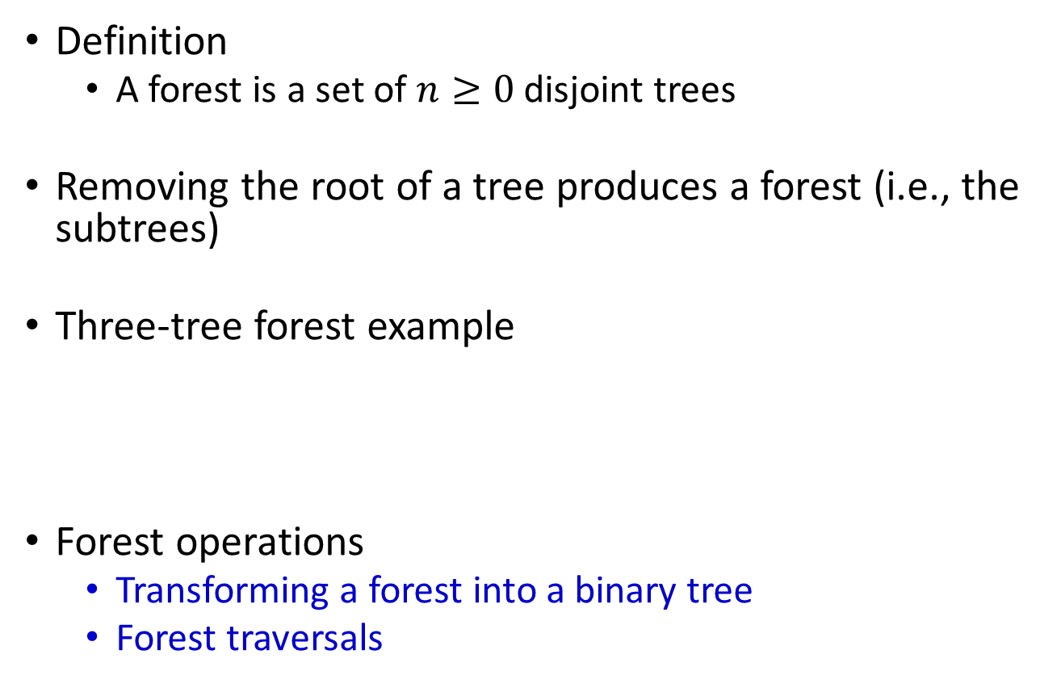
Forest
Definition
A forest is a set of $n≥0$ disjoint trees
Removing the root of a tree produces a forest (i.e., the subtrees)
Three-tree forest example
Forest operations
Transforming a forest into a binary tree
Forest traversals
A
E
G
B
C
D
F
H
I

Slide 307
Forest to Binary Tree
Left-child-right-sibling approach
A
E
G
A
B
C
D
F
H
I
B
E
C
F
G
A
E
G
D
H
I
B
C
D
F
H
I

Slide 308
Recap Inorder Tree Traversal
Recursive definition
Tree
=
{
}
L subtree
R subtree
,
,
Root node

Slide 309
Recap Inorder Tree Traversal
Example
A
B
E
B
E
=
{
}
C
A
F
G
,
,
C
F
G
D
H
D
H
I
I

Slide 310
Inorder Forest Traversal
Recursive definition
1
2
3
4
2
3
4
=
{
}
,
,
Subtrees (i.e., a forest) of the 1st tree
Root node
of the 1st tree
All trees (i.e., a forest) except the 1st tree

Slide 311
Inorder Forest Traversal
Recursive definition
A
E
G
=
{
E
G
}
B
C
D
A
B
C
D
F
H
I
,
,
F
H
I

Slide 312
Forest Traversals (Preorder)
Traverse F in forest preorder
If F is empty then return
Visit the root of the first tree of F
Traverse the subtrees of the first tree in forest preorder
Traverse the remaining trees of F in forest preorder
A
E
G
A
B
C
D
F
H
I
B
E
C
F
G
A B C D E F G H I
D
H
I
A B C D E F G H I

Slide 313
Forest Traversals (Inorder)
Traverse F in forest inorder
If F is empty then return
Traverse the subtrees of the first tree in forest inorder
Visit the root of the first tree of F
Traverse the remaining trees of F in forest inorder
A
E
G
A
B
C
D
F
H
I
B
E
C
F
G
B C D A F E H I G
D
H
I
B C D A F E H I G

Slide 314
Forest Traversals (Postorder)
Traverse F in forest postorder
If F is empty then return
Traverse the subtrees of the first tree in forest postorder
Traverse the remaining trees of F in forest postorder
Visit the root of the first tree of F
A
E
G
A
B
C
D
F
H
I
B
E
C
F
G
B C D F H I G E A
D
H
I
D C B F I H G E A

Slide 315
Forest Traversals (Level-Order)
Traverse F in forest level-order
If F is empty then return
Nodes are visited by level
Begin the traversal from the roots of each tree in the forest
Within each level, nodes are visited from left to right
A
E
G
A
B
C
D
F
H
I
B
E
C
F
G
A E G B C D F H I
D
H
I
A B E C F G D H I

Slide 316
Outline
5.1 Introduction
5.2-5.5 Binary trees
5.6 Heaps
5.7 Binary search trees → Dictionary
5.8 Selection trees
5.9 Forests
5.10 Disjoint sets
(5.11 Counting binary trees)

Slide 317
Set Representation
Use of trees to represent sets (use root to represent the tree = root represent the set)
Elements: {0, 1, 2, 3, ..., n-1}
indices into a symbol table where actual names are stored
Assume that the sets being represented are mutually disjoint (S_{i}∩S_{i} = φ if i ≠ j)
For example
S₁ = {0, 6, 7, 8}
S₂ = {1, 4, 9}
S₃ = {2, 3, 5}

Slide 318
Set Operations
Disjoint set union
If S_{i} and S_{j} are two disjoint sets, then S_{i}∪S_{j} = {all elements x such that x is in S_{i} or S_{j}}
For example S₁∪S₂ = {0, 6, 7, 8, 1, 4, 9}
Find(i)
Find the set containing i.
For examples
3 is in set S₃
8 is in set S₁
Find(3) → 2
Find(8) → 0
Find(9) → 4

Slide 319
Union Operation

Slide 320
Data Structure
Symbol Table and Sets
A table entry is (set name, pointer)
Array indicating a node’s parent
i | [0] | [1] | [2] | [3] | [4] | [5] | [6] | [7] | [8] | [9]
parent | -1 | 4 | -1 | 2 | -1 | 2 | 0 | 0 | 0 | 4

Slide 321
Class and Constructor for Sets
class Sets {
public:
// Set operations (Union, Find) follow
private:
int *parent;
int n; // number of set elements
};
Sets:Sets(int numberOfElements){
if(numberOfElements<2) throw “must have >=2 elements”;
n = numberOfElements;
parent = new int[n];
fill (parent, parent + n – 1, -1);
}

Slide 322
Simple Functions for Union and Find
void Sets::SimpleUnion(int i, int j)
// replace the disjoint sets with roots i and j, i != j
// with their union
{
parent[i] = j;
}
int Sets::SimpleFind(int i)
{ // Find the root of the tree containing element i.
while( parent[i] >=0) i = parent[i];
return i;
}

Slide 323
Worst-Case Scenario
Consider the following union-find operations
Union(0, 1), Union(1, 2), Union(2, 3), Union(3, 4), ..., Union(n-2, n-1),
Find(0), Find(1), ..., Find(n-1)
The results
n-1
Find(0) = O(n)
Find(1) = O(n-1)
Find(2) = O(n-2)
…
Find(n-1) = O(1)
---------------------
Total = O(n²)
.
.
2
2
1
1
1
……
0
0
0

Slide 324
Weighted Rule for Union(i, j)
Definition
If the number of nodes in the tree with root i is less than the number in the tree with root j, then make j the parent of i; otherwise make i the parent of j.
Data Structure
A count field in the root node is used to indicate the total number of elements in the tree
parent[i] = - 1 → parent[i] = - count if i is a root node of a tree

Slide 325
Trees Obtained Using The Weighted Rule

Slide 326
Union Function with Weighting Rule
void Sets::WeightedUnion(int i, int j)
// Union sets with roots i and j, i ≠j, using the weighted rule
// parent[i] = -count[i] and parent[j] = -count[j]
{
int temp = parent[i] + parent[j];
if (parent[i] > parent[j]) { // i has fewer nodes
parent[i] = j;
parent[j] = temp;
}
else { //j has fewer nodes or i & j have the same number of nodes
parent[j] = i;
parent[i] = temp;
}
}
It is provable that: The height of the tree created by a sequence of unions
over one-node trees is no greater than floor(log2 n) + 1

Slide 327
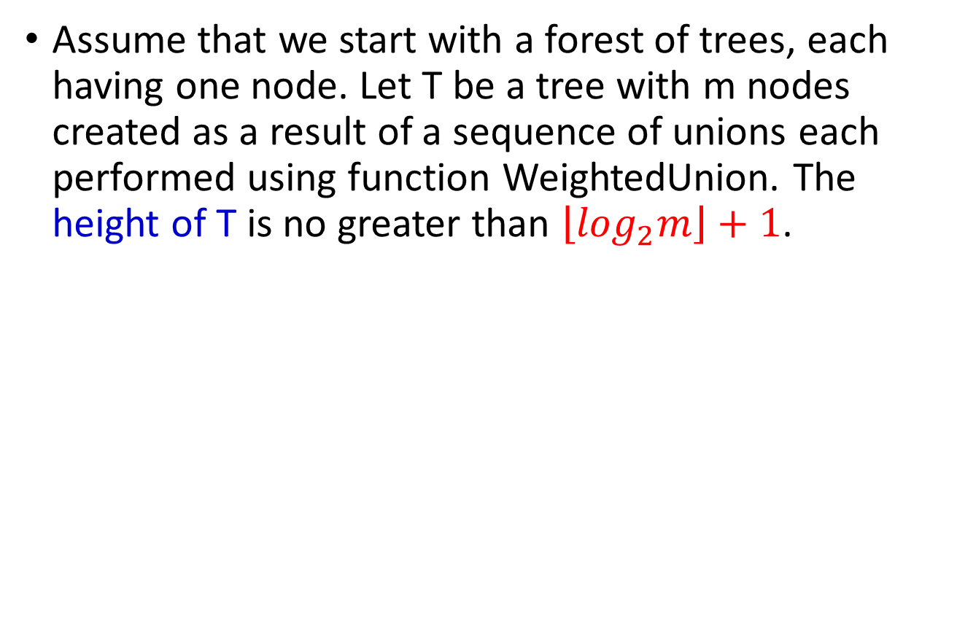
Lemma 5.5
Assume that we start with a forest of trees, each having one node. Let T be a tree with m nodes created as a result of a sequence of unions each performed using function WeightedUnion. The height of T is no greater than $\left\lfloor \log_{2}m\right\rfloor +1$.

Slide 328
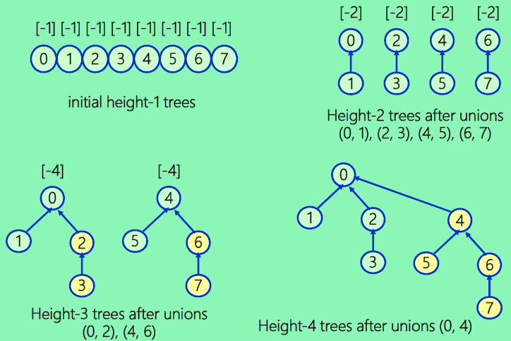
Trees Achieving Worst-Case Bound

Slide 329
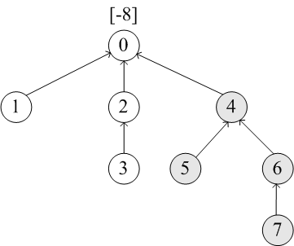
Collapsing Rule for Union(i, j)
Definition
If j is a node on the path from i to its root and parent[i] ≠ root(i), then set parent[j] to root(i)
Example
Processing eight find operations:
Find(7), Find(7), ..., Find(7)
SimpleFind
→ 3*8 = 24 moves
CollapsingFind
→ 3 + 3 + 1 + 1+ 1+ 1+ 1+ 1+ 1 = 13 moves
1st Find(7): including traversal & collapsing

Slide 330
Find Algorithm With Collapsing Rule
int Sets::CollapsingFind(int i)
// Find the root of the tree containing element i
// Use the collapsing rule to collapse all nodes from i to the root
{
for(int r=i; parent[r] >= 0; r=parent[r]); // find root
while ( r != i ) {
int s = parent[i];
parent[i] = r;
i = s;
}
return r;
}

Slide 331
Application To Equivalence Classes
Consider the equivalence pair processing problem of Section 4.9.
The equivalence classes to be generated may be regarded as sets.
These sets are disjoint, as no polygon can be in two equivalence classes.
Initially, all n polygons are in an equivalence class of their own; thus parent[i] = -1, 0 ≤ i < n.
If an equivalence pair i ≡ j, is to be processed, we must first determine the sets containing i and j. If these are different, then two sets are to be replaced by their union. If not, nothing happens.

Slide 332
Application To Equivalence Classes

Slide 333
Application To Equivalence Classes

Slide 334
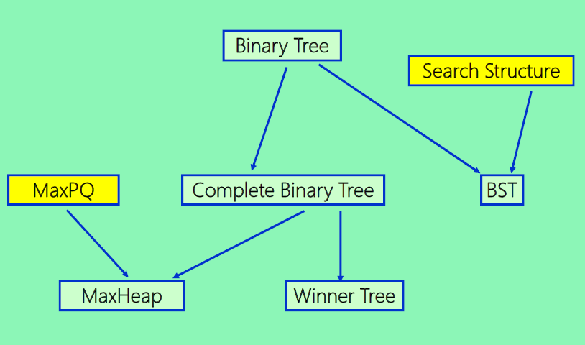
Inheritance Graph Among Trees

Slide 335
Outline
5.1 Introduction
5.2-5.5 Binary trees
5.6 Heaps
5.7 Binary search trees → Dictionary
5.8 Selection trees
5.9 Forests
5.10 Disjoint sets
5.11 Counting binary trees

Slide 336
Counting Binary Trees
Problem 1
What is the total possible number of distinct binary trees having n nodes?
Problem 2
What is the number of permutations of the numbers from 1 through n obtainable by a stack ?
Problem 3
What is the number of distinct ways of multiplying n+1 matrices ?
→ All the three problems have the same answer!

Slide 337
Example: Distinct Binary Trees
n = 3

Slide 338
Inorder & Preorder Sequences of a BT
Its pre-order sequence (permutation) is 1 2 3 4 5 6 7 8 9
Its in-order sequence (permutation) is 2 3 1 5 4 7 8 6 9

Slide 339
Distinct Binary Trees According To A Preorder / Inorder Sequence Pair
Given
the pre-order sequence A B C D E F G H I
the in-order sequence B C A E D G H F I
Question
Does the given information defines a unique tree ?
Construction Process

Slide 340
Tree Construction Using Pre-order and In-order Information
Pre-order: A B C D E F G H I
In-order: B C A E D G H F I
A unique tree exists !
Given information is valid !

Slide 341
Number of Distinct Binary Trees
If the nodes of the tree are numbered such that its preorder permutation is 1, 2,…, n, then it follows that distinct binary trees define distinct inorder permutation!
Thus the number of distinct binary trees equal to the number of distinct inorder permutations obtainable from binary trees having the preorder permutation 1, 2, .., n.
Using the concept of an inorder permutation, we can show that the number of distinct permutations obtainable by passing the numbers 1 through n through a stack and deleting in all possible ways is equal to the number of distinct binary trees with n nodes.

Slide 342
Possible Permutations Obtainable by Stack for 3 Inputs
Start with 3 numbers: (1, 2, 3)
The possible permutations obtainable by a stack are:
(1, 2, 3) (1, 3, 2) (2, 1, 3) (2, 3, 1) (3, 2, 1)
Obtaining (3, 1, 2) is impossible.

Slide 343
What Orders Are Valid ?
Given
the pre-order sequence A B C
the in-order sequence C A B
Question
Is the given order corresponds to any binary tree ?
Answer
No, there is no binary tree according to this order pair
after processing the node A
using the construction rules
A
violate the inorder
B
C

Slide 344
Stack Permutations

Slide 345
Example of Invalid Order Pair
The following is not valid
the pre-order sequence: 1 2 3 4 5 6 7 8 9 10
the in-order sequence: 1 8 . . 2 . . 4 . .
1
2
When partitioning the tree based on node 2
→ node 8 is in the left sub-tree,
→ while node 4 in the right sub-tree
→ will violate the preorder 8 < 4
8
4

